Slide 1
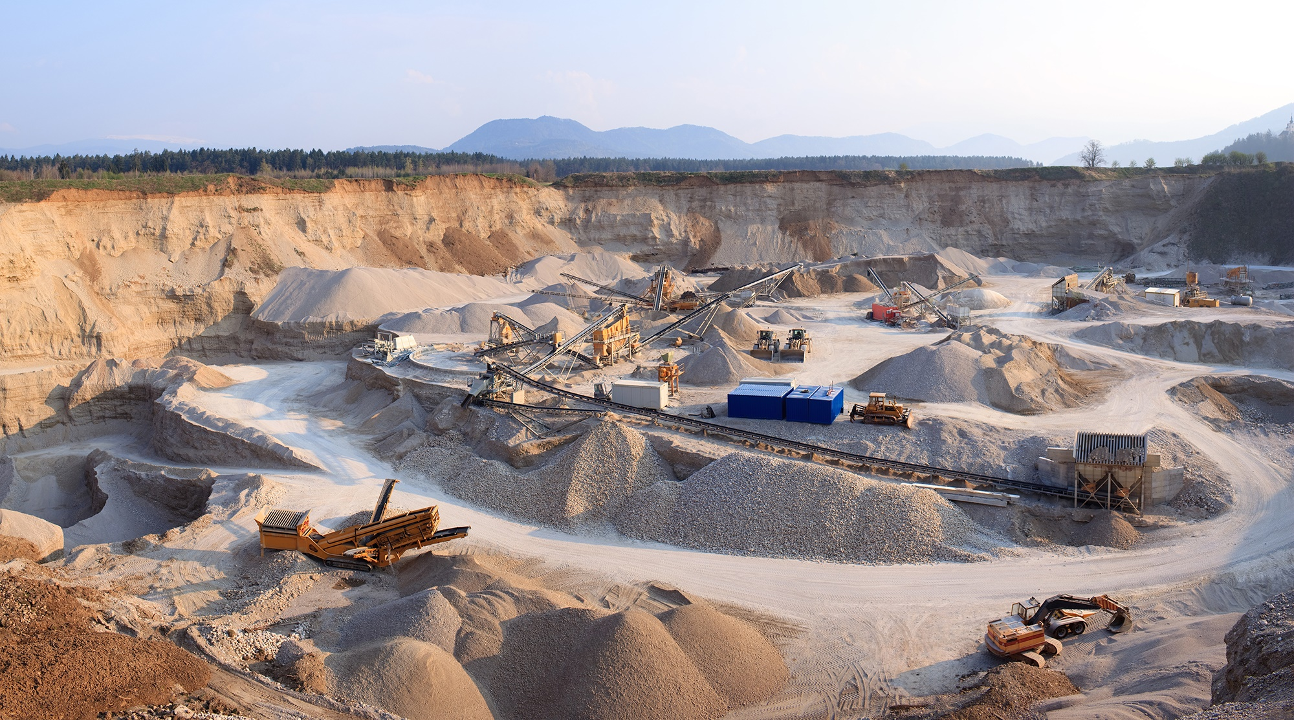

Construction Materials
Outlook
December 2023
www.fmicapitaladvisors.com
FMI Capital Advisors, Inc. is a wholly-owned subsidiary of FMI Corporation
Registered Broker / Dealer | Member FINRA
FOR DISCUSSION PURPOSES ONLY

Slide 2





WHO we are
FMI is a leading investment banking and consulting firm dedicated exclusively to the built environment. We serve as the industry’s trusted advisor, providing current market insights, deep industry research, and key relationships that deliver tangible results for our clients.
Industry
Insiders
Capital Advisors
Consulting & Research

Slide 3






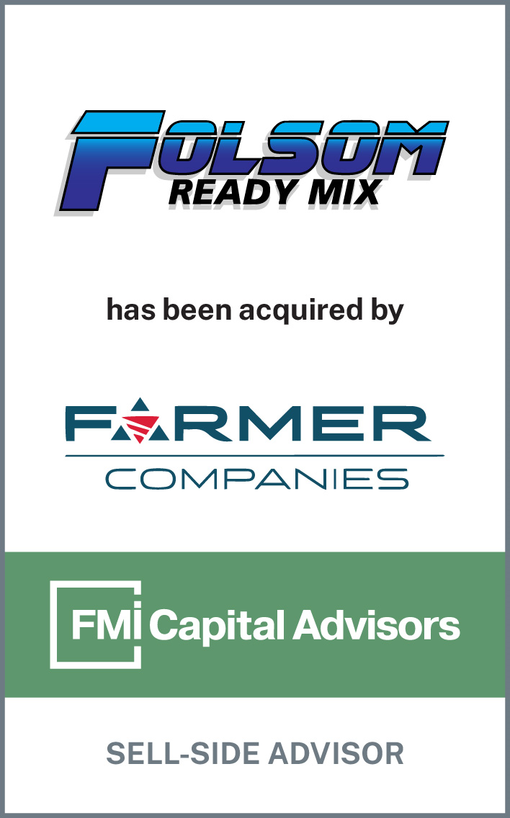
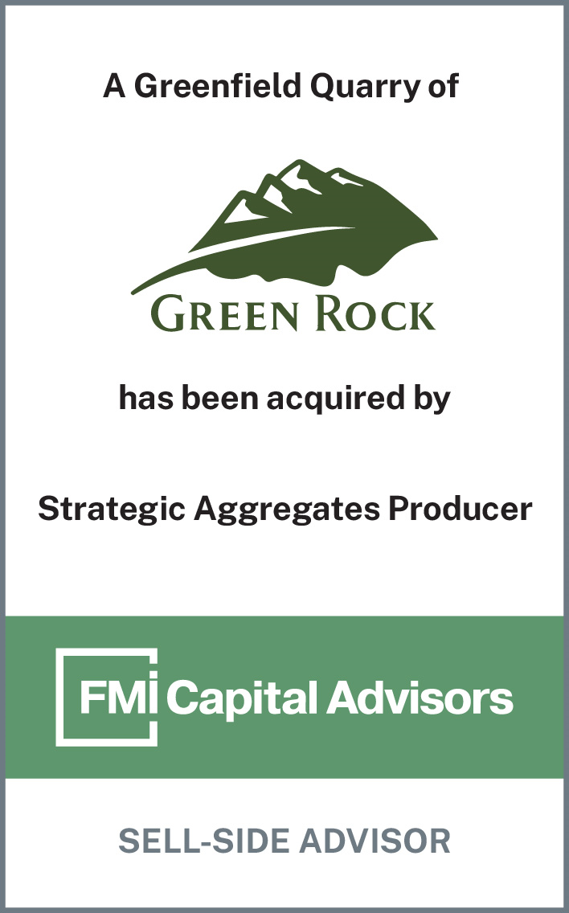
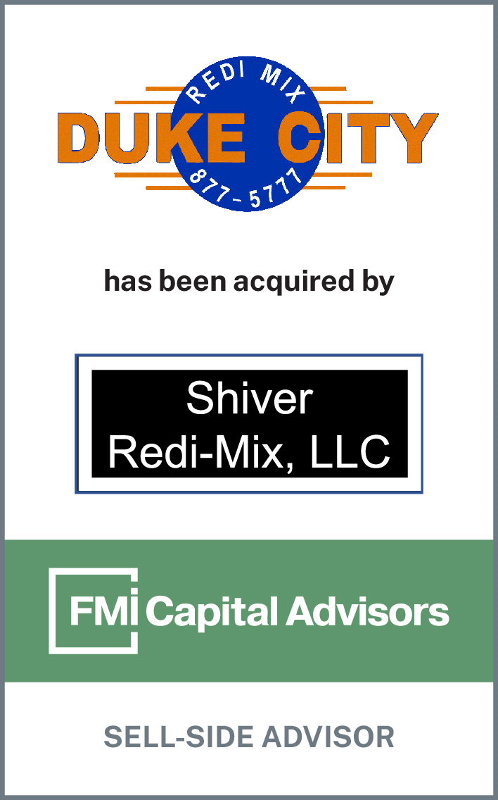
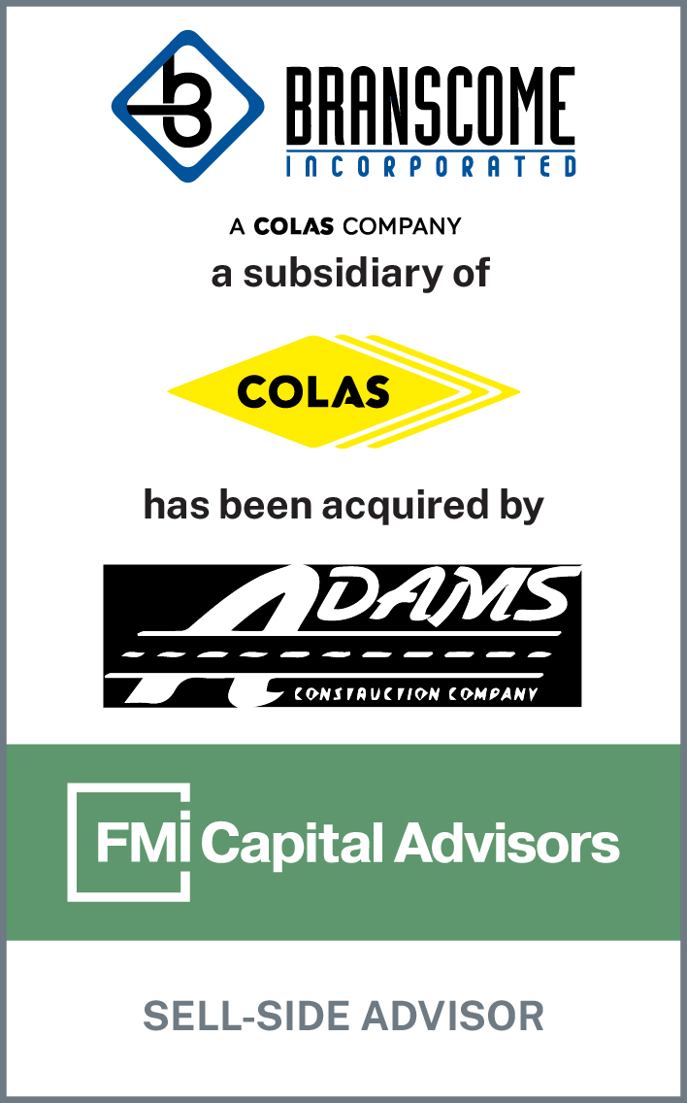

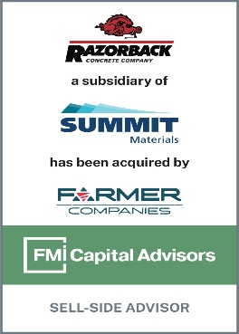

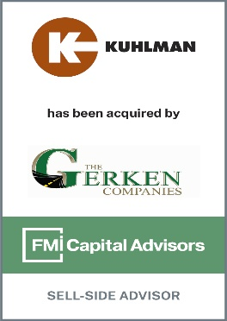
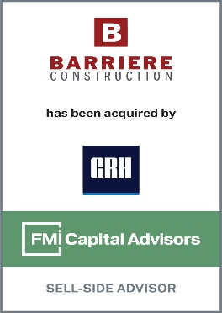
Specializing in CONSTRUCTION MATERIALS
35
100
+
YEARS OF EXPERIENCE
+
TRANSACTIONS
More than any peer advisory group
Servicing All Segments of the Supply Chain
Active Members in Industry Organizations
Aggregates
  Crushed Stone | Sand | Gravel
  Concrete (RMC) | Asphalt (HMA)
Products
  Asphalt Paving | Road Construction |
  Paving Maintenance
Construction
Recent Transaction Advisory

Slide 4



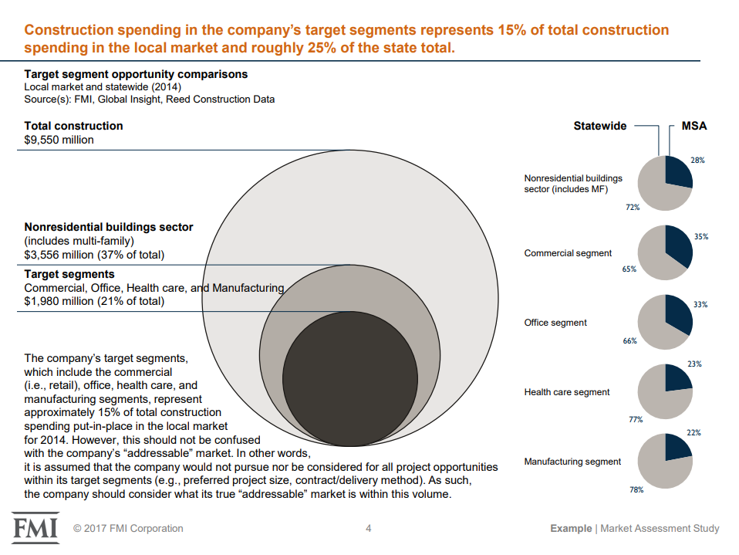
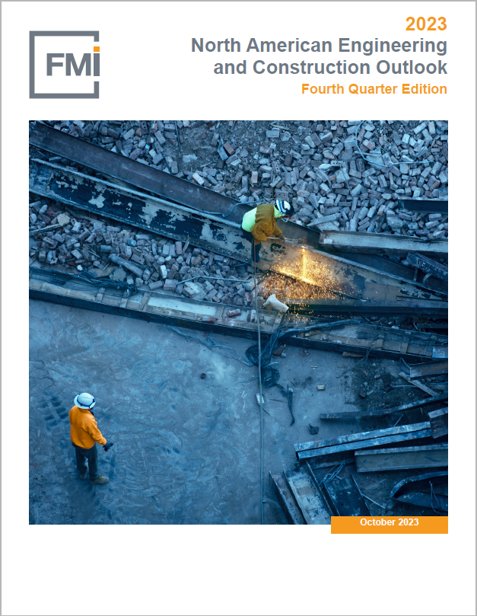


Consulting and Research
CM Focused Consulting
Global Research
Wallace Marshall
Head of Construction Materials,
Management Consulting
O: 919.785.9382
E: wallace.marshall@fmicorp.com
Jay Bowman
Partner,
Research and Analytics
O: 919.785.9336
C: 919.782.6679
E: jay.bowman@fmicorp.com
Jay Bowman
Partner,
Research and Analytics
O: 919.785.9336
C: 919.782.6679
E: jay.bowman@fmicorp.com
Jay Bowman
Partner, Research and Analytics
O: 919.785.9336
C: 919.782.6679
E: jay.bowman@fmicorp.com
Brian Strawberry
Senior Economist
O: 919.785.9246
C: 919.760.5656
E: brian.strawberry@fmicorp.com
Education: B.A. University of Georgia
MBA East Carolina University
Experience: Market Sizing and Forecasting
Education: B.A. Appalachian State University
Education: B.A. University of Georgia
Education: B.A. Elon University
Education: Ph.D. Boston College
Education: MBA East Carolina University
Education: MBA UNC Greensboro
Experience: Construction Materials and Market Research
Experience: Market Sizing and Forecasting
Experience: Market Sizing and Forecasting
Management Consulting Capabilities:
Leadership development
Field productivity improvement
Business strategic planning
Acquisition integration
Compensation analysis
Market studies

Slide 5
Construction Materials Update

Slide 6






Outlook for Construction Materials
Despite the negative headlines, there are reasons to be optimistic for Construction Materials
Category
Sentiment
Earnings Call Quotes
Demand
"With the layering of federal infrastructure dollars, there is a meaningful runway for construction projects for years to come.”
– Michael Haack: CEO, President & Director
Pricing
“Pricing momentum remains strong across our markets with average organic pricing up high single digits…”
– Gail Peck: CFO
Backlogs
"...there has been a consistent increase in our backlog for 11 quarters. It's very unusual in this business."
– Gregory Hoffman: CFO
Public Funding
“…record state departments of transportation budgets…will provide sustained multiyear demand…”
– Ward Nye: Chairman, CEO & President
"If weather cooperates and the construction season is extended, we could exceed expectations. But as a managerial team, we don't make a habit of predicting Q4 weather conditions."
– Scott Anderson: Executive VP, CFO
Weather
“…we're encouraged by the recent growth in single family permits and starts…over the last 3 months. On the other hand…multifamily starts have now begin to pull back…” – Tom Hill: President & CEO
Residential
Source: Q3 2023 Earnings Call Transcripts

Slide 7




U.S. Pricing and Volume Dynamics – Q3 2023 vs. Q3 2022
U.S. Sales Volumes – Aggregates, Concrete, Asphalt, & Cement
U.S. Product Pricing
Q3 2022
6.0%
2.6%
Q3 2023 vs. Q3 2022 | Aggs | RMC | HMA | Cement
CEMEX | 9.0% | 16.0% | N/A | 10.0%
Cementos Argos | N/A | 14.3% | N/A | 13.2%
Eagle Materials | 2.6% | 8.3% | N/A | 14.7%
Knife River | 16.2% | 11.6% | 14.9% | N/A
Summit Materials | 14.4% | 8.2% | 16.3% | 13.9%
Martin Marietta | 20.0% | 21.0% | 6.7% | 18.9%
Vulcan Materials | 14.9% | 10.7% | 1.9% | N/A
GCC | N/A | 17.1% | N/A | 12.4%
Avg Increase | 12.8% | 13.4% | 9.9% | 13.8%
Q3 2023
3.6%
3.6%
7.1%
4.4%
  Volumes are down, but producers continue to successfully implement price increases
Source: Q3 2023 Investor Presentations and Regulatory Filings
Note: Eagle Materials reporting Q2 2024

Slide 8







Construction Materials Index (CMI) Performance – Q3 2023 vs. Q3 2022
CMI Revenue
($ in Billions)
Q3 2022
Average 9.5%
    Aggregate Volumes 3.4%
Q3 2023
3.6%
15.5%
10.1%
4.7%
17.9%
20.9%
-2.0%
2.8%
14.4%
7.3%
5.6%
11.8%
10.7%
CMI EBITDA
($ in Billions)
Q3 2022
26.2%
Q3 2023
Average 33.9%
40.2%
32.3%
18.7%
35.0%
76.0%
-1.5%
8.9%
76.9%
35.8%
12.8%
43.0%
36.2%
Source: CapIQ, USGS, Q3 2023 Investor Presentations and Regulatory Filings
Note: Eagle Materials reporting Q2 2024

Slide 9
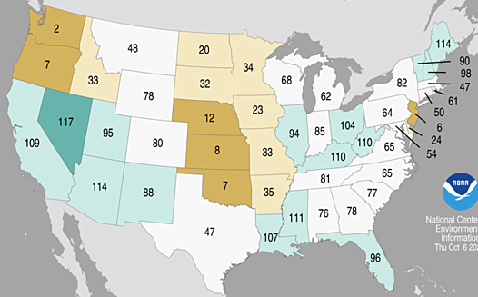
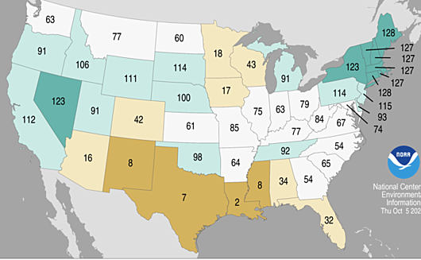
Aggregate Volumes – Region Outperforming U.S. Overall
USGS Aggregate Production Data
YoY % Change | Q1 2022 | Q2 2022 | Q3 2022 | Q4 2022 | Q1 2023 | Q2 2023 | Q3 2023 | TTM
United States | 6.4% | 3.7% | 5.1% | -5.2% | -2.1% | -1.7% | -3.4% | -3.1%
East North Central Division | 1.7% | 2.6% | 7.1% | 3.5% | 8.3% | 6.9% | -0.9% | 3.6%
Illinois | 29.7% | -3.6% | -1.6% | 9.7% | 11.9% | 12.3% | -10.7% | 3.5%
Q3 2022 Precipitation by State
Q3 2023 Precipitation by State
Record Wettest
Record Wettest
Below Average
Below Average
Much Above Average
Much Above Average
Much Below Average
Much Below Average
Above Average
Above Average
Record Driest
Record Driest
Near Average
Near Average
Note: USGS aggregate figures are based on a survey of industry participants
Source: NOAA, USGS

Slide 10



Total U.S. Market – Construction Put-in-Place (CPiP)
Macro uncertainties abound, but strong demand and funding secure the outlook for construction materials
Construction Put-in-Place (1997 – 2024F)
($ in Billions)
Grey bars denote recessions, Blue bars denote forecast
FMI Q4 Outlook Takeaways:
Recession expectation is late 2023 or early 2024
Growth in 2023 for multi-family, manufacturing, highway and street, sewage and waste disposal, and water supply
Office: Data centers will continue to outperform
Commercial: New warehouse development is expected to slow
1
Residential Buildings
2
Nonresidential Buildings
3
Nonbuilding Structures
Single-Family
Multi-Family
Home Improvements
Commercial
Manufacturing
Transportation
Health Care
Educational
Religious
Public Safety
Office
Communication
Lodging
Recreation
Highway & Street
Sewage & Waste Disposal
Power
Water Supply
Conservation & Development
Note: Q4 2023 Forecast based on Q2 2023 Actuals and Q3 2023 Assumptions; CPiP Segments defined by U.S. Census Bureau;
BOLD CATEGORIES DENOTE STRONGEST CONSTRUCTION MATERIAL DRIVERS

Slide 11
The East North Central Division – Construction Put-in-Place (CPiP)
East North Central Division
Construction Put-in-Place (1997 – 2024F)
($ in Billions)
Grey bars denote recessions, Blue bars denote forecast
Residential
Nonresidential
Nonbuilding
    The East North Central Division is one of nine geographic divisions that FMI Research tracks in its analysis of construction trends
Note: Q4 2023 Forecast based on Q2 2023 Actuals and Q3 2023 Assumptions; CPiP Segments defined by U.S. Census Bureau

Slide 12


Residential Construction – Disconnect in Supply and Demand
There is a fundamental supply - demand disconnect in the residential housing market
Supply: Housing Shortage – Avg. Annual Starts
<
Demand: Increasing Generational Housing Demand
(in Millions)
U.S. Population (1980): 227M
U.S. Population (2022): 332M
Single-Family
Multi-Family
Ages of 1st Time Buyers
82.1M
89.3M
83.4M
64.8M
12.3M
-700k
Continued demand for new housing brought on by:
Homeowners unwilling to give up ~2% mortgage rates
Decade+ period of declining housing starts
Generational demand with growing population of prime homebuying demographic
To maintain our standard of living every U.S. citizen annually needs:
+
7,254 lbs of sand & gravel
10,765 lbs of stone
Source: U.S. Census Bureau, USGS

Slide 13
Residential Construction – Single-Family Dynamics
(1) Affordability Issues: Mortgage Rates
(2a) Lack of Supply: Existing Single-Family Home Sales
    “80% of outstanding U.S. mortgages have an interest rate below 5%”
    – WSJ
(in Millions; Seasonally Adjusted Annual Rate)
5.7M
3.4M
    “Homeowners are unwilling to let go of cheap mortgages they got when rates were scraping bottom.”
    – Bloomberg
30-Yr. Mortgage Rate
15-Yr. Mortgage Rate
(2b) Lack of Supply: Flat Housing Starts
(3) Current Residential Dynamics: Cheaper to Rent
    “The only way to get [home] prices down sustainably is to increase supply.”
    – Redfin
Multi-Family
    Average mortgage is 52% more expensive than average rent
Cheaper to Rent
Single-Family
Cheaper to Buy
-15%
-9%
Source: CBRE, Freddie Mac, NAHB, St. Louis FRED

Slide 14
Residential Construction Put-in-Place – United States & East North Central Division
Single-Family CPiP (U.S.)
Multi-Family CPiP (U.S.)
(13%)
$392 Billion
2023/2022 Comparison
18%
$140 Billion
2023/2022 Comparison
2021
UP
37%
$424B
2021
UP
15%
$115B
2022
UP
7%
$454B
2022
STA
3%
$118B
2023
DWN
(13%)
$392B
2023
UP
18%
$140B
2024
DWN
(10%)
$354B
2024
DWN
(7%)
$131B
Single-Family CPiP (East North Central)
Multi-Family CPiP (East North Central)
(8%)
$20 Billion
2023/2022 Comparison
16%
$9 Billion
2023/2022 Comparison
2021
UP
32%
$20B
2021
UP
21%
$7B
2022
UP
7%
$21B
2022
STA
1%
$7B
2023
DWN
(8%)
$20B
2023
UP
16%
$9B
2024
DWN
(10%)
$18B
2024
DWN
(5%)
$8B
Note: Q4 2023 Forecast based on Q2 2023 Actuals and Q3 2023 Assumptions; CPiP Segments defined by U.S. Census Bureau

Slide 15
Residential Construction – Single-Family (Illinois)
Population Migration
Residential Construction – Single-Family
Illinois Population Trends 2008-2022
East North Central Single-Family Permit Issuance 2008-2022 CAGR
    Recent population decline
    Declining permit issuance
<0%
-1.4%
0% to 1.5%
1.6% to 3%
3.1%+
    SF Housing permits YoY through Oct ’23:
    Illinois: (11%)
    United States: (11%)
    SF Housing start projections 2023 & 2024:
    Illinois: 0% and 1%
    United States: (9%) and 4%
Source: NAHB, U.S. Census Bureau, St. Louis FRED

Slide 16
Nonresidential Construction – A Mixed Bag
Key Areas of Nonresidential Construction Demand
YoY % Change | 2023F |  | 2024F
 | U.S. | E.N.C. | U.S. | E.N.C.
Manufacturing | 58% | 62% | 15% | 11%
Lodging | 16% | 13% | 4% | (3%)
Health Care | 9% | 11% | 6% | 8%
Public Safety | 9% | 4% | 10% | 14%
Amusement & Recreation | 8% | 15% | 4% | 3%
Educational | 8% | 4% | 7% | 5%
Office | 8% | 7% | (4%) | 2%
Transportation | 7% | 12% | 12% | 16%
Commercial | 6% | 7% | (9%) | (8%)
Religious | 4% | 4% | 1% | (1%)
Communication | 2% | 2% | 4% | 4%
Total Nonresidential | 17% | 20% | 5% | 5%
One bad apple can spoil the barrel; one good egg doesn't make a dozen
E-Commerce: Warehouse & distribution make up >50% of Commercial
Manufacturing & CHIPS Act: CHIPS Act invests ~$53B over the next 5 years
Travel & Entertainment: Post-pandemic life shows tailwinds for lodging and amusement & recreation
U.S. Manufacturing Construction Spending
($ in Billions)
Manufacturing spending experiencing explosive growth on the heels of public funding deployment
Source: FMI, St. Louis FRED

Slide 17
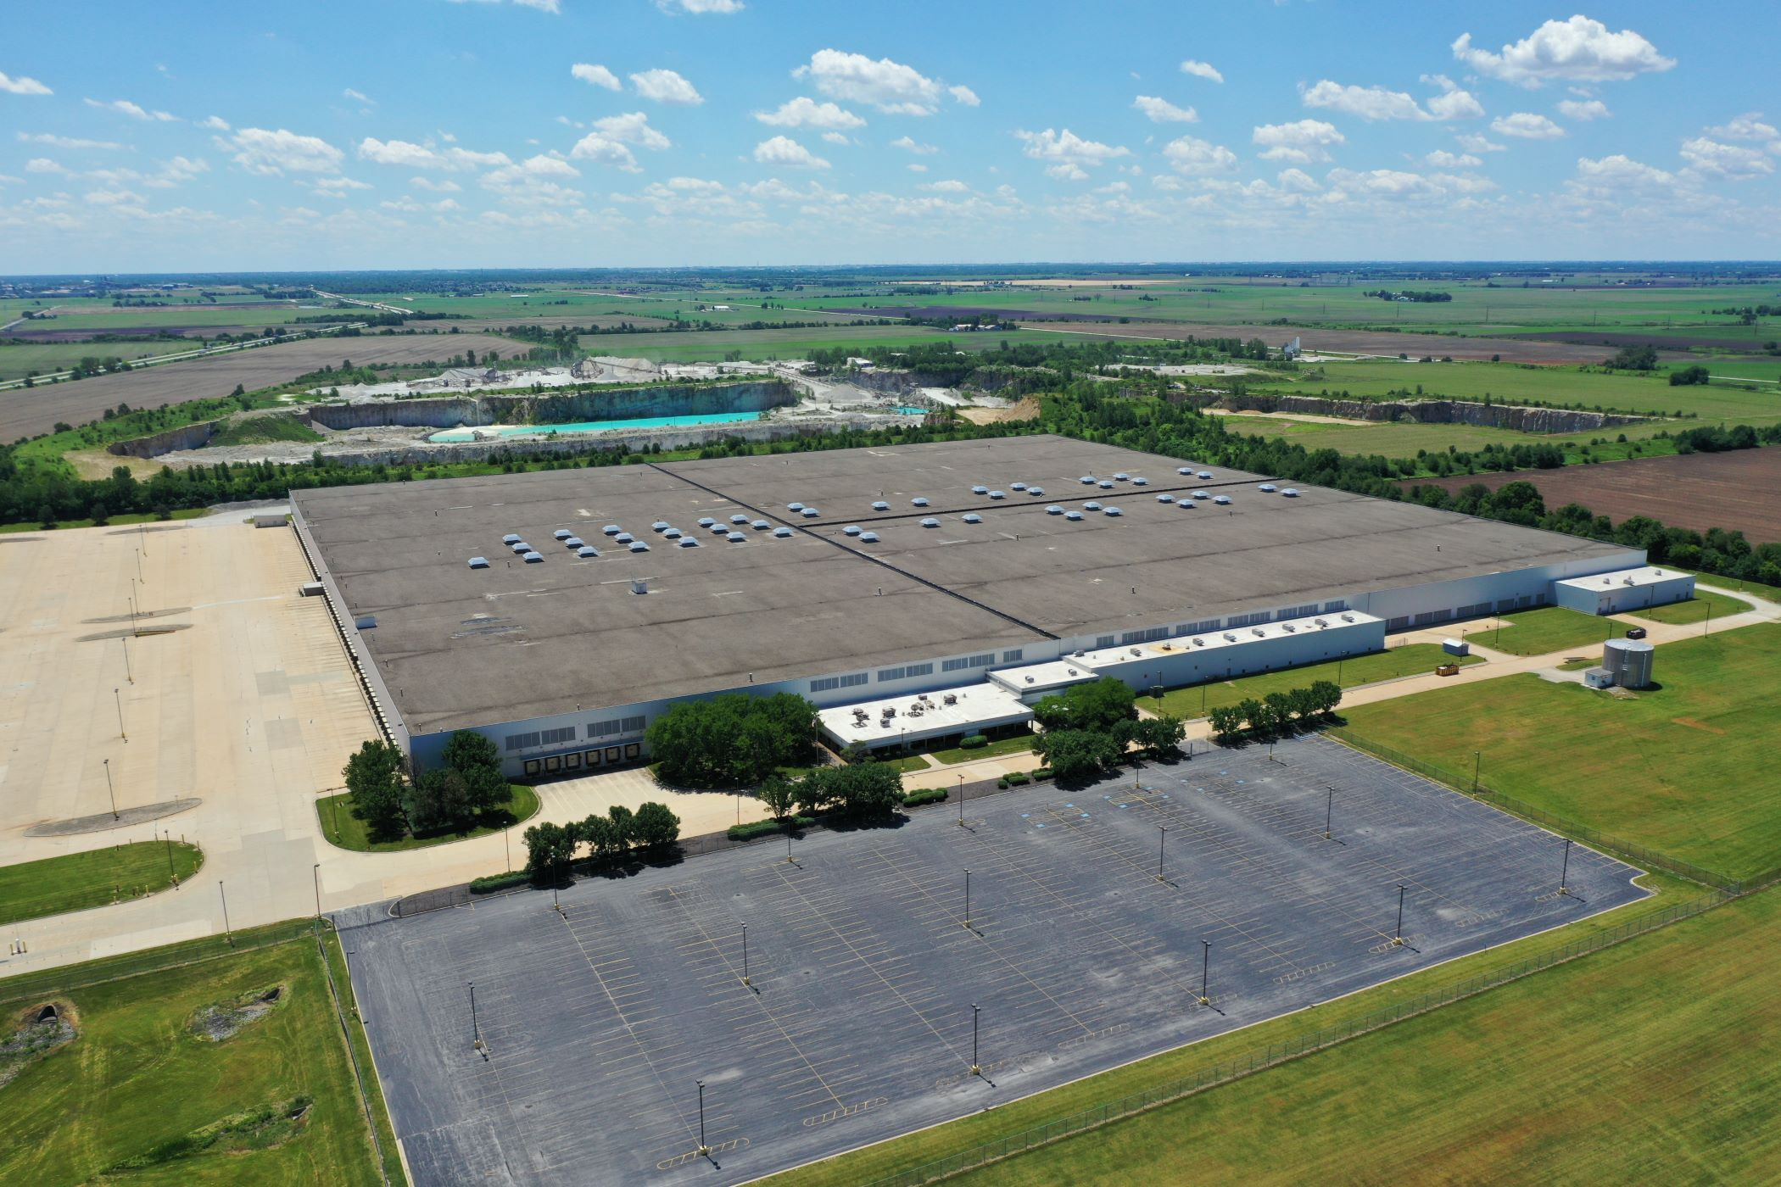
Nonresidential Construction – CHIPS and Science Act and Relevant Local Projects
Semiconductor Market Share
CHIPS and Science Act of 2022
Rest of World
The semiconductor industry represents ~$575B globally
The U.S. has been losing market share in the space for decades
COVID-19 exposed faults in the U.S. supply chain as demand for electronics soared while major exporters closed their borders
To incentivize investment in U.S. semiconductor manufacturing, the Federal CHIPS and Science Act was passed, apportioning $53B for U.S. semiconductor manufacturing and R&D
U.S.
Manufacturing CPiP (East North Central)
Case Study: Gotion
62%
$31 Billion
2023/2022 Comparison
Chinese battery-maker Gotion plans to open a $2B facility creating ~2,600 new jobs
Location: Manteno, IL
Size: 153 Acres
Start Date: 2024
2021
UP
14%
$12B
2022
UP
55%
$19B
2023
UP
62%
$31B
2024
UP
11%
$34B
Source: CoStar, FMI, IL Gov, Semiconductor Industry Association, The White House

Slide 18
Nonbuilding Construction – Comparison of Highway Authorization Bills
The IIJA is a “once-in-a-generation” infrastructure bill with huge implications for Construction Materials
Federal Road and Bridge Funding
30% - 55% Increase From FAST Act
General Fund Appropriations
$62B
ARRA
$26B
Extension
ISTEA
TEA-21
SAFTEA-LU
MAP-21
FAST ACT
IIJA
Source: FHWA, FMI Research

Slide 19
Nonbuilding Construction – State and Federal Funding
Road & Bridge Network
Illinois State Funding
Increase in Federal Funding
Miles of Road by State:
East North Central Division
2024-2029 State Highway Program
Illinois Federal Funding⁽¹⁾
~26% increase over FAST Act
State | Rank
IL | 1
OH | 2
MI | 3
WI | 4
IN | 5
240k
Road Maintenance
256k
Bridge Maintenance
~$21B
System Expansion
307k
203k
262k
System Support
Safety/System
Modernization
FAST Act
IIJA
Illinois has the most roadway based on miles in the East North Central Division
As of 2023 Illinois had ~2.5k bridges that are structurally deficient
In July, IDOT announced the 2024-2029 State Highway Program, apportioning ~$21B to the maintenance of the state highway system
~$10B of total funding will go toward road maintenance and expansion
IIJA provides Illinois with ~$9.8B
On average, IIJA funding is 26% greater than 2021 FAST Act funding
(1) Figures only show Federal-Aid Highway Program apportionments
Source: ARTBA, FHWA, IDOT

Slide 20
Construction Put-in-Place – Winners and Losers
2023 Construction Put-in-Place & Forecast Growth (2022-2024 CAGR)
CAGR 2022-2024 for All Spending
2.2%
($ in Billions)
Note: Q4 2023 Forecast based on Q2 2023 Actuals and Q3 2023 Assumptions; CPiP Segments defined by U.S. Census Bureau;
BOLD CATEGORIES DENOTE STRONGEST CONSTRUCTION MATERIAL DRIVERS

Slide 21









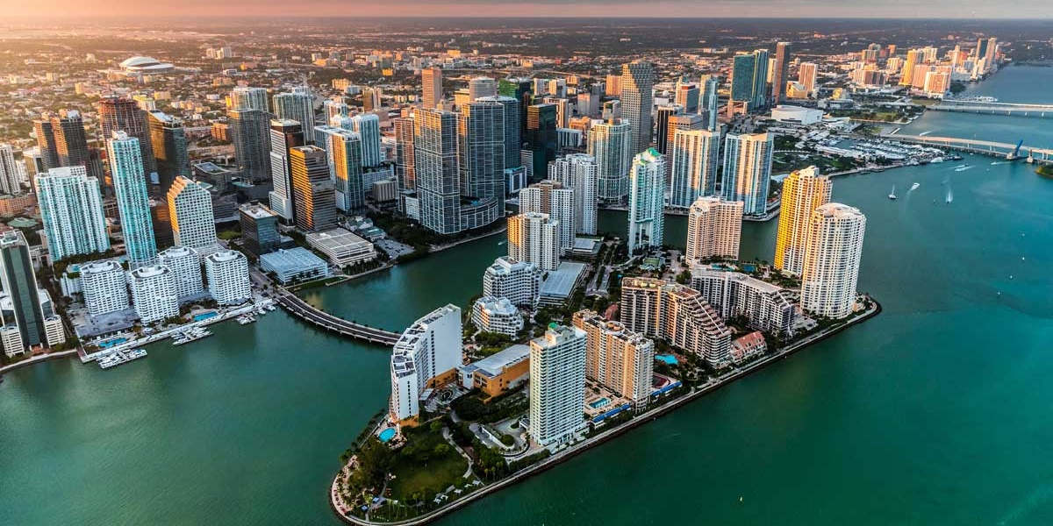

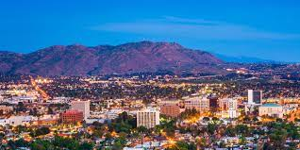
All Construction is Local
More than 1-in-3 Construction Dollars are Spent in just 12 Markets
35% of U.S. CPiP
New York
Los Angeles
Dallas
Houston
Phoenix
Atlanta
Seattle
Washington, DC
San Francisco
Miami
Chicago
Riverside
50% of U.S. CPiP
Denver
Austin
Boston
Philadelphia
Orlando
Tampa
Minneapolis
Charlotte
San Diego
Portland

Slide 22



Headwinds
Inflation
Potential Recession
Labor

Slide 23

Inflation – What the Fed is Watching
CPI vs. Core PCE
Federal Funds Rate
2% Inflation Target
Core PCE
CPI
3.5%
3.2%
Commentary
Producer Price Index – Construction vs. All
Fed focuses on Core PCE because it accounts for consumer behavior (substituting for lower priced goods)
At the November FOMC meeting, Chairman Powell stressed that no decisions have been made yet regarding rate hikes in December
Rise in sustained borrowing costs would be a substitute for rate hikes
Construction PPI, once the highest of the four inflation measurements shown, has declined to <1%
PPI: Construction
PPI: All
CPI
3.2%
1.3%
0.7%
Source: Barclays, CNBC, FactSet, St. Louis FRED

Slide 24

Potential Recession – Historic Indicators
Economic indicators are raising red flags that a recession may be on the horizon
10-Yr & 2-Yr Treasury Yield Differential
Predictive Indicators
Prediction Strength Historically
Risk Assessment
Grey bars denote recessions
X
Predictive Recessionary Flag
Yield Curve Inversion
100%
High
New Home Sales
86%
High
Money Supply
75%
High
U.S. Trade Balance (BOP % Change)
57%
High
MBS Held by Banks
50%
High
Months Supply of New Homes
50%
High
Unemployment Rate
71%
Moderate
X
X
X
X
X
X
Lumber Sales
67%
Moderate
“…the gap is collapsing because of economic strength, not weakness, with longer-term yields rising instead of short-term yields falling.” - WSJ
Stock Market Performance
50%
Moderate
Copper Price
50%
Moderate
Source: FMI, Federal Reserve Bank of Atlanta, U.S. BEA

Slide 25
Potential Recession – How Strong is the Economy?
Real GDP Change
(Annualized, Seasonally Adjusted)
A recession is defined as two consecutive quarters of GDP decline, but NBER is the governing body that declares official recessions
Q3 2023 was significantly better than expected
“We could even have a soft landing. I just think more inflationary forces are out there…”
– Jamie Dimon, JP Morgan Chase
2019
2020
2021
2022
2023
Understanding the Components of GDP
Q3 2023 v Q2 2023
Consumer spending makes up ~2/3 of total U.S. GDP
Consumers continue to spend although signs of slowing (0.2% increase MoM for October)
Consumers are also saving less and sentiment is waning
C
Personal Expenditures
$136.0B
+
I
Gross Private Domestic Investment
$101.3B
+
G
Government Expenditures
$51.2B
+
(X–M)
Net Exports of Goods and Services
-$7.3B
“One of the big things forecasters got wrong was consumer spending. It grew at a 4% annual rate in the third quarter…”
– WSJ
GDP
$281.0B
Note: Q3 GDP and components from U.S. BEA Second Estimate as of 11/29/23
Source: Federal Reserve Bank of Atlanta, U.S. BEA

Slide 26
Potential Recession – Consumer Indicators
Pandemic Era Excess Savings Held by U.S. Households
Savings Rate as a % of Disposable Income
($ in Trillions)
Avg. Jan 2018 – Oct 2023
Pandemic-era cash reserves are being depleted
32.0%
Savings rate has declined
3.8%
Commentary
Consumer Probability of Job Loss Over the Next Year
The Pandemic was the first recession in U.S. history where disposable income went up
Cash savings built up during the pandemic are winding down
However, consumers have more job security and continue to spend
Consumers have more job security
Source: New York Fed, San Francisco Fed, St. Louis Fred

Slide 27
Potential Recession – Consumer Indicators
Consumer Credit Card Debt
Outstanding Student Loans Owned and Securitized
($ in Trillions)
$1T Threshold
($ in Trillions)
Credit card debt has surpassed $1T
Student loan payments resumed in October 2023
Commentary
Consumer Sentiment Index
49% of adults have less or no savings compared to last year, and 1/3 more credit card debt than cash
Moody’s predicts the economy will struggle in Q4 due to student loan repayments
Excluding pandemic lows, consumer sentiment is at its lowest point since 2011
(Index:1966 Q1=100)
Consumer sentiment is down
Source: Moody’s, New York Fed, St. Louis FRED, University of Michigan

Slide 28




Labor
Labor Force Participation Rate vs. Monthly Job Openings
Monthly Job Creation
Avg. Jan 2017 – Dec 2019
October 2023 jobs report missed expectations:
150,000 jobs created vs. 170,000 expected
Monthly job creation has been greater than pre-pandemic average
Are people rejoining the labor force now that “cash cushion” is gone?
Resilient labor market could impact Fed decision making
Labor force participation has been steadily increasing
Dwindling Construction Workforce
AGC Survey – Hiring Will Become:
Recruiting the next generation of talent will be key in mitigating the construction labor shortage
41% of the current construction workforce will be retired by the year 2031
Source: St. Louis FRED

Slide 29







Other Factors Driving GDP
The Good
The Bad
Wages are growing faster than inflation
Student loan repayments coming back online
Lower prices for goods due to supply chain resolutions
Recent miss in labor market expectations
Corporate investment in inventories (+1.4% to GDP Growth in Q3)
Increasing rates on mortgages and credit cards
Lower Gasoline and fuel prices
Continued World Turmoil
  There is a “Jekyll and Hyde” Dynamic in the Economy
Source: U.S. BEA

Slide 30
Industry Sentiment & Performance

Slide 31
Public CM Company Performance – Last Twelve Months
CMI vs. Major Indexes (November 2022 – November 2023)
Construction Materials has outperformed the broader market in the past ~8 months
Potential Reasons:
Perceived “stability” vs. macroeconomic uncertainty
Strong funding
Demonstrated pricing power
Demonstrated margin recovery
Residential is a “mixed-bag”
35%
12%
4%
CM Index
S&P 500
DJIA
Source: S&P CapIQ as of 11/30/2023
FMI’s CM Index includes: Arcosa, Inc., Buzzi Unicem S.p.A., Cementos Argos S.A., CEMEX, S.A.B. de C.V., Colas SA, Construction Partners, Inc., CRH plc, Eagle Materials, Inc., Granite Construction Incorporated, Grupo Cementos de Chihuahua, S.A.B. de C.V., HeidelbergCement AG, Holcim Ltd, Knife River Corporation, Martin Marietta Materials, Inc., Summit Materials, Inc., The Monarch Cement Company, Titan Cement International S.A., Vulcan Materials Company

Slide 32
Public CM Company Performance – Year to Date
CMI vs. Major Indexes (YTD November 30th, 2023)
Construction Materials has outperformed the broader market in the past ~8 months
Potential Reasons:
38%
Perceived “stability” vs. macroeconomic uncertainty
Strong funding
Demonstrated pricing power
Demonstrated margin recovery
Residential is a “mixed-bag”
19%
8%
CM Index
S&P 500
DJIA
Source: S&P CapIQ as of 11/30/2023
FMI’s CM Index includes: Arcosa, Inc., Buzzi Unicem S.p.A., Cementos Argos S.A., CEMEX, S.A.B. de C.V., Colas SA, Construction Partners, Inc., CRH plc, Eagle Materials, Inc., Granite Construction Incorporated, Grupo Cementos de Chihuahua, S.A.B. de C.V., HeidelbergCement AG, Holcim Ltd, Knife River Corporation, Martin Marietta Materials, Inc., Summit Materials, Inc., The Monarch Cement Company, Titan Cement International S.A., Vulcan Materials Company

Slide 33
The Market is Up – S&P 500 vs. the “Magnificent Seven”
The S&P 500 Index is up 19% YTD, but really there are seven companies boosting returns
S&P 500 – Normal vs. Equal Weighting
“The Magnificent Seven” YTD Returns
S&P 500 Index
19%
S&P Equal Weighted Index
4%
S&P 500 Index is market-cap weighted, so companies with larger market caps have greater impact on the index
The Magnificent Seven account for ~28% of the S&P 500’s total weight, and have returned 106% in 2023 on average
An equal weighted S&P yields flat year-to-date returns
Source: S&P CapIQ as of 11/30/2023, CNBC, FactSet

Slide 34
Public CM Company Performance – Checking the “Vital Signs” (Positioned for Growth)
CMI Cash vs. Total Debt
CMI Median Net Debt/EBITDA
($ In Billions)
Cash
Total Debt
Mean Debt: $65.7B
Above Average Leverage Capacity
Mean: 2.8x
Mean Cash: $14.9B
CMI Average EBITDA Margin
CMI TEV/EBITDA
Stable Performance
Mean: 17.7%
Historically Volatile Valuations
Mean: 9.3x
Source: CapIQ; Total Enterprise Value (TEV) defined as market capitalization plus debt minus cash & cash equivalents; market data as of 11/30/2023

Slide 35
How Confident is the Market?
Heavy Civil Construction Index (HCCI)
Nonresidential Construction Index (NRCI)
Current Reading
52.6
Current Reading
45.9
Previous Reading
56.1
Previous Reading
49.8
NAHB/WF Housing Market Index (HMI)
FMI’s HCCI and NRCI surveys ask one question: “What is the outlook for your business next quarter”
Readings above 50 on all the indexes indicate expansion
Homebuilders & industry experts have a pessimistic outlook
Current Reading
34
Previous Reading
40
Source: FMI, NAHB

Slide 36
Backlogs and Employment
As backlogs continue to build, CM firms will be looking to add more employees to perform the work
U.S. Construction Backlog by Quarter
AGC Survey for Hiring Expectations over NTM
(In Months)
Mean (2017 – YTD 2023): 8.7 months
Expect Headcount to:
Expect it will become / continue to be:
Source: Associated Builders and Contractors, Associated General Contractors of America

Slide 37




Trends & Takeaways
ESG
Mergers & Acquisitions
Growth Trends
Industry Outlook Conclusion

Slide 38









Trends & Takeaways – Environmental, Social, and Governance (ESG)
Growing Number of U.S. Sustainable Funds
CM-Specific Initiatives
2
Social
Passive Funds
1
Environmental
Active Funds
Vulcan Materials Company Foundation
Assets ($ in Billions)
$541M
Uses company funds to match employee contributions to charitable organizations
Committed in
“Green CapEx”
Environmental
    Investor sentiment for ESG has risen significantly in recent years
ESG
Social
Governance
$34M invested over past 5 years in local communities
3
Governance – Board
Diversity & Independence
Community Relations
Independent Directors
Diverse Directors
$7.2M
2022 Community Donations
Humanitarian Relief
91%
45%
Females & Minorities
Education & Employment
89%
56% Female
Environment & Conservation
Other
Source: CRH 2022 Sustainability Report, Holcim ESG Report 2022, Martin Marietta 2021 ESG Report, Morningstar, Summit Materials 2022 ESG Report, The Wall Street Journal, Vulcan Materials 2021 ESG Report

Slide 39













Trends & Takeaways – Mergers and Acquisitions
CM Deals 2017 – YTD 2023
The Market is PRIMED for M&A activity
2019: CM players lost substantial market cap in late 2018 leading to uncertainty in 2019
H1 2020: Sector experienced low deal volume due to COVID
H2 2020 - 2021: Deals have increased due to returned optimism
2022: M&A continued at a high level due to IIJA expectations
2023: Flight to safety with bolt-on acquisitions
Recent activity from “Majors”
Major Buyers
37 RMC plants in CO, TX, & WY
Select Acquisitions
28 RMC plants in NY, NJ, & PA
North America Assets
20 RMC plants and 1 cement plant in TX
82 RMC plants, 11 volumetric locations in TX
Global uncertainty has forced investors to a “flight to safety” for CM buyers, those targets are bolt-on acquisitions
Source: Merger Market, Wallstreet Research; Market data and deals as of 11/30/2023

Slide 40

Trends & Takeaways – Growth is Steady but Modest
U.S. Construction Aggregates Produced
U.S. Ready-Mixed Concrete Produced
Crushed Stone
Sand & Gravel
1.7% CAGR
Metric Tons (millions)
Cubic Yards (millions)
3.0% CAGR
U.S. Asphalt Tons Produced
U.S. Cement Produced (Domestic)
2.4% CAGR
Tons (millions)
2.8% CAGR
Metric Tons (millions)
Source: NAPA, NRMCA, USGS

Slide 41

Trends & Takeaways – Outlook for Construction Materials
Category
Sentiment
Outlook
Demand
Near-term demand remains strong
Pricing
Pricing will continue to improve
Backlogs
Backlogs remain healthy
Committed public funding will sustain the CM Sector
Public Funding
Weather
CM Companies will continue to closely monitor weather patterns in their markets
Industry leaders are cautiously optimistic as slowdowns in residential have been milder than expected
Residential
The Construction Materials industry is well-positioned to weather a potential macroeconomic downturn

Slide 42


Scan for industry insights, recent transactions, and an overview of FMI Capital Advisors Construction Materials
George Reddin
Managing Director
919.349.1919
george.reddin@fmicorp.com
Rob Mineo
Managing Director
919.539.6861
rob.mineo@fmicorp.com
Evan Coughlin
Vice President
919.407.0469
evan.coughlin@fmicorp.com
FMI Capital Advisors
223 S. West Street
Suite 1200
Raleigh, NC 27603
Mark Schachte
Analyst
919.616.4573
mark.schachte@fmicorp.com
Matt Berendsen
Analyst
919.943.9902
matt.berendsen@fmicorp.com

