Slide 1
Contractor, Truckers, & MSHA
IAAP Mine Safety Conference
December 5, 2023
Nicholas “Nick” W. Scala
Chair of Conn Maciel Carey’s MSHA • Workplace Safety Group

Slide 2
Nicholas W. Scala nscala@connmaciel.com • 614.418.6048
Nick Scala is a Chair of the national MSHA • Workplace Safety Practice at Conn Maciel Carey LLP and a Certified Mine Safety Professional. He focuses on all aspects of mine safety and health law:
  Represents mine operators and independent contractors in inspections, investigations & enforcement actions involving MSHA
  Advises clients in all phases of involvement with MSHA, particularly guiding companies through contest proceedings before the Federal Mine Safety and Health Review Commission
  Prepares clients for and manages incident, fatality, and special investigations conducted by MSHA, and defends company representatives in section 110 proceedings, and represents companies in discriminations/interference investigations and proceedings

Slide 3
Who is Responsible and Can be Cited?

Slide 4
Who is Responsible?
The Mine Act is a Strict Liability statute:
Strict Liability
  Liability that does NOT depend on actual negligence or intent to harm, but that is based on the break of an absolute duty to make something safe. Black’s Law Dictionary 9th Edition
What does that mean?
  Mine production-operator is always going to be open to liability for any action that takes place on mine property. Even the actions of persons who are not their employees.

Slide 5
Who can be issued Citations/Order?
MSHA Program Policy Manual Volume III– Part 45
Production-operators are subject to all provisions of the Act, and to all standards and regulations applicable to their mining operations. This overall compliance responsibility includes assuring compliance by independent contractors with the Act and with applicable standards and regulations. As a result, both independent contractors and production-operators are responsible for compliance with all applicable provisions of the Act, standards and regulations.
This "overlapping" compliance responsibility means that there may be circumstances in which it is appropriate to issue citations or orders to both the independent contractor and to the production-operator for a violation.

Slide 6
Who can be issued Citations/Order?
MSHA Program Policy Manual Volume III– Part 45
Enforcement action against a production-operator for a violation(s) involving an independent contractor is normally appropriate in any of the following situations:
(1) when the production-operator has contributed by either an act or by an omission to the occurrence of a violation in the course of an independent contractor's work;
(2) when the production-operator has contributed by either an act or omission to the continued existence of a violation committed by an independent contractor;

Slide 7
Who can be issued Citations/Order?
MSHA Program Policy Manual Volume III– Part 45
Enforcement action against a production-operator for a violation(s) involving an independent contractor is normally appropriate in any of the following situations:
(3) when the production operator's miners are exposed to the hazard; or
(4) when the production-operator has control over the condition that needs abatement.

Slide 8
Operator or Independent Contractor?
30 CFR 45.2 (Independent Contractors) and 46.2
  Production-operator: means any owner, lessee, or other person who operates, controls or supervises a coal or other mine.
  Independent contractor: means any person, partnership, corporation, subsidiary of a corporation, firm, association or other organization that contracts to perform services or construction at a mine.

Slide 9
Operator or Independent Contractor?
30 CFR 45.2 (Independent Contractors) and 46.2
  Operator: means any production-operator, or any independent contractor whose employees perform services at a mine.
30 CFR 48.2
  Operator: Any owner, lessee or other person who operates, controls or supervises an underground mine; or any independent contractor identified as an operator performing services or construction at such mine

Slide 10
Operator or Independent Contractor?
30 CFR 46.2
Miner:
(1) (i) Any person, including any operator or supervisor, who works at a mine and who is engaged in mining operations. This definition includes independent contractors and employees of independent contractors who are engaged in mining operations; and
(ii) Any construction worker who is exposed to hazards of mining operations.

Slide 11
Operator or Independent Contractor?
30 CFR 46.2
Miner: (cont.)
(2) The definition of “miner” does not include scientific workers; delivery workers; customers (including commercial over-the-road truck drivers); vendors; or visitors.
This definition also does not include maintenance or service workers who do not work at a mine site for frequent or extended periods.

Slide 12
Operator or Independent Contractor?
30 CFR 46.2
Mining Operations:
Extraction
Milling
Crushing
Screening
Sizing of minerals at a mine
Mine development
Drilling & blasting
Maintenance and repair of mining equipment
Associated haulage of materials within the mine from these activities.

Slide 13
Operator or Independent Contractor?
30 CFR 46.2
Miner: (cont.)
  Frequent or Extended Periods???
  "Frequent" exposure is defined as a pattern of exposure to hazards at mining operations occurring intermittently and repeatedly over time.
  "Extended" exposure means exposure to hazards at mining operations of more than five consecutive workdays.
    From MSHA Program Policy Manual (46.2(g))

Slide 14
Who Maintains Which Records?

Slide 15
Who Maintains Which Records?
A contractor must have MSHA ID if performing:
Mine development, including shaft and slope sinking;
Construction or reconstruction of mine facilities;
Demolition of mine facilities;
Construction of dams;
Excavation or earthmoving involving mobile equipment
Equipment installation;
Equipment service or repair for a period of 5 consecutive days at a particular mine;
Material handling within mine property; and
Drilling and blasting.

Slide 16
Who Maintains Which Records?
Training Plans:
All contractors who employ miners should maintain their own training plan.
Contractors working in Part 46 and Part 48 mines can develop, maintain and work under a Part 48 plan at both types of facilities.
Production-operator must ensure that contractors working on their site are properly trained and should ensure this before contractors begin work on site.

Slide 17
Who is Responsible for What Training?
§46.12 Responsibility for independent contractor training.
(a)(1) Each production-operator has primary responsibility for ensuring that site-specific hazard awareness training is given to employees of independent contractors who are required to receive such training under §46.11 of this part.
(2) Each production-operator must provide information to each independent contractor who employs a person at the mine on site-specific mine hazards and the obligation of the contractor to comply with our regulations, including the requirements of this part.

Slide 18
Who is Responsible for What Training?
§46.12 Responsibility for independent contractor training. (cont.)
(b)(1) Each independent contractor who employs a miner, as defined in §46.2, at the mine has primary responsibility for complying with §§46.3 through 46.10 of this part, including providing new miner training, newly hired experienced miner training, new task training, and annual refresher training.
(2) The independent contractor must inform the production-operator of any hazards of which the contractor is aware that may be created by the performance of the contractor's work at the mine.

Slide 19
Who is Responsible for What Training?
§48 – Training for Miners In Underground Mines, Surface Areas of Underground Mines and Surface Mines
PPM: Compliance Responsibility
Each operator is responsible for complying with all applicable provisions of Part 48
PPM 48.2/.22(e)
Independent contractors are responsible for the Part 48 training of their employees…a contractor may have his/her own training plan or may utilize the mine operator’s plan

Slide 20
Who is Responsible for What Training?
§48 – Hazard Training
Independent contractor exposure to hazards varies from situation to situation. Hazard training must be tailored to fit the training needs of the particular contractor. Training these contractors receive must be of sufficient content and duration to thoroughly cover the mine-specific conditions, procedures, and safety devices. Training must include hazards incident to the performance of all job assignments by the contractor at the mine.

Slide 21
Who is Responsible for What Training?
§48.11 Hazard Training – Underground Mines
(1) Hazard recognition and avoidance;
(2) Emergency and evacuation procedures;
(3) Health and safety standards, safety rules, and safe working procedures;
(4) Use of self-rescue and respiratory devices, including:
(i) Hands-on training in the complete donning of all types of self-contained self-rescue devices used at the mine, which includes assuming a donning position, opening the device, activating the device, inserting the mouthpiece, and putting on the nose clip; and
(ii) Hands-on training in transferring between all applicable self-rescue devices; and
(5) Such other instruction as may be required by the District Manager based on circumstances and conditions at the mine.
(b) Miners shall receive the instruction required by this section at least once every 12 months.
(c) The training program required by this section shall be submitted with the training plan required by §48.3(a) (Training plans: Submission and approval) of this subpart A and shall include a statement on the methods of instruction to be used.
(d) In accordance with §48.9 (Records of training) of this subpart A, the operator shall maintain and make available for inspection certificates that miners have received the hazard training required by this section.
(e) Miners subject to hazard training shall be accompanied at all times while underground by an experienced miner, as defined in §48.2(b) (Definition of miner) of this subpart A.

Slide 22
Who is Responsible for What Training?
§48.31 Hazard Training – Surface Mine or Surface Operations of Underground Mine
(1) Hazard recognition and avoidance;
(2) Emergency and evacuation procedures;
(3) Health and safety standards, safety rules and safe working procedures;
(4) Self-rescue and respiratory devices; and,
(5) Such other instruction as may be required by the District Manager based on circumstances and conditions at the mine.
(b) Miners shall receive the instruction required by this section at least once every 12 months.
(c) The training program required by this section shall be submitted with the training plan required by §48.23(a) (Training plans: Submission and approval) of this subpart B and shall include a statement on the methods of instruction to be used.
(d) In accordance with §48.29 (Records of training) of this subpart B, the operator shall maintain and make available for inspection, certificates that miners have received the instruction required by this section

Slide 23
Task Training
30 C.F.R. §46.7
(a) You must provide any miner who is reassigned to a new task in which he or she has no previous work experience with training in the health and safety aspects of the task to be assigned, including the safe work procedures of such task, information about the physical and health hazards of chemicals in the miner's work area, the protective measures a miner can take against these hazards, and the contents of the mine's HazCom program. This training must be provided before the miner performs the new task.

Slide 24
Task Training
30 C.F.R. §48.7
(a) Miners assigned to new work tasks as mobile equipment operators, drilling machine operators, haulage and conveyor systems operators, roof and ground control machine operators, and those in blasting operations shall not perform new work tasks in these categories until training prescribed in this paragraph and paragraph (b) of this section has been completed. This training shall not be required for miners who have been trained and who have demonstrated safe operating procedures for such new work tasks within 12 months preceding assignment. This training shall also not be required for miners who have performed the new work tasks and who have demonstrated safe operating procedures for such new work tasks within 12 months preceding assignment. The training program shall include the following:

Slide 25
Documentation Requirements and Best Practices
Part 50 Injury and Illness Records:
Contractors required to maintain a contractor ID must report:
  Accidents, injuries and illnesses under 50.20;
  Quarterly employment reports under 50.30; and
  Records of such reports under 50.40.
ALL Contractors must comply with Immediate notification requirements
  Mine Operators should also file injury and illness reports and immediately contact MSHA within 15 minutes of becoming aware of situation under 50.10.

Slide 26
Best Practices with Contractors
§45.4 Independent contractor register.
(a) Each independent contractor shall provide the production-operator in writing the following information:
  (1) The independent contractor's trade name, business address and business telephone number;
  (2) A description of the nature of the work to be performed by the independent contractor and where at the mine the work is to be performed;
  (3) The independent contractor's MSHA identification number, if any; and
  (4) The independent contractor's address of record for service of citations, or other documents involving the independent contractor.
(b) Each production-operator shall maintain in writing at the mine the information required by paragraph (a) of this section for each independent contractor at the mine. The production-operator shall make this information available to any authorized representative of the Secretary upon request.

Slide 27
MSHA Enforcement and Best Practices

Slide 28
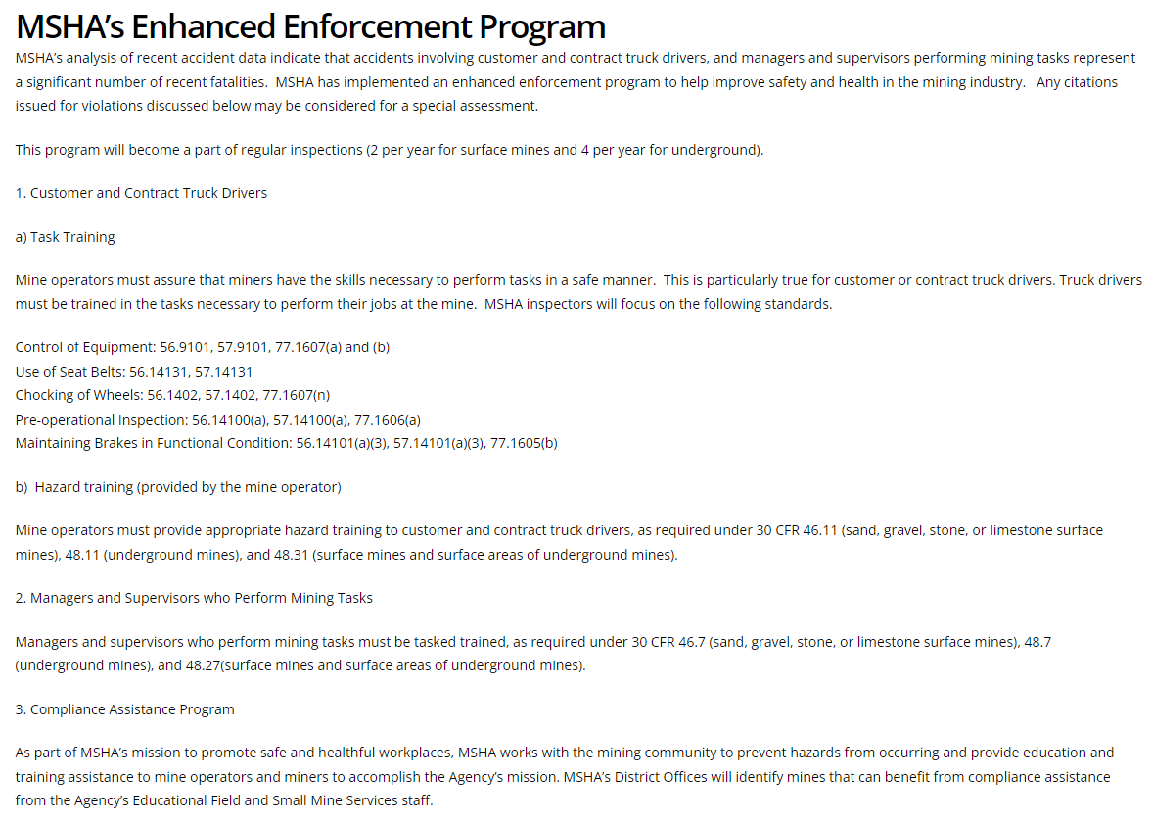
2022 Enhanced Enforcement

Slide 29
2022 Enhanced Enforcement
1. Customer and Contract Truck Drivers
  a) Task Training
Mine operators must assure that miners have the skills necessary to perform tasks in a safe manner. This is particularly true for customer or contract truck drivers. Truck drivers must be trained in the tasks necessary to perform their jobs at the mine. MSHA inspectors will focus on the following standards.
    Control of Equipment: 56.9101, 57.9101, 77.1607(a) and (b)
    Use of Seat Belts: 56.14131, 57.14131
    Chocking of Wheels: 56.1402, 57.1402, 77.1607(n)
    Pre-operational Inspection: 56.14100(a), 57.14100(a), 77.1606(a)
    Maintaining Brakes in Functional Condition: 56.14101(a)(3), 57.14101(a)(3), 77.1605(b)
  b) Hazard training (provided by the mine operator)
Mine operators must provide appropriate hazard training to customer and contract truck drivers, as required under 30 CFR 46.11 (sand, gravel, stone, or limestone surface mines), 48.11 (underground mines), and 48.31 (surface mines and surface areas of underground mines).

Slide 30
2022 Enhanced Enforcement
2. Managers and Supervisors who Perform Mining Tasks
Managers and supervisors who perform mining tasks must be tasked trained, as required under 30 CFR 46.7 (sand, gravel, stone, or limestone surface mines), 48.7 (underground mines), and 48.27(surface mines and surface areas of underground mines).

Slide 31
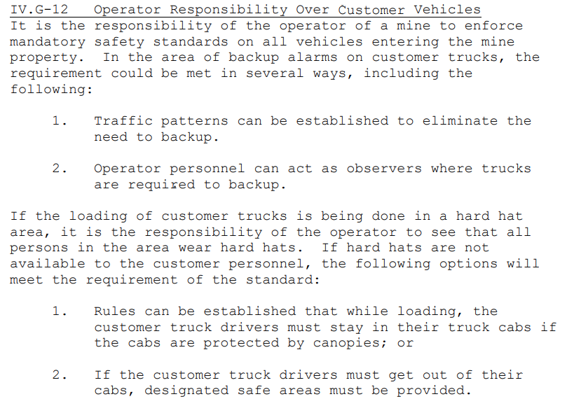
Customer Trucks / Drivers on Site
MSHA Program Policy Vol. IV

Slide 32
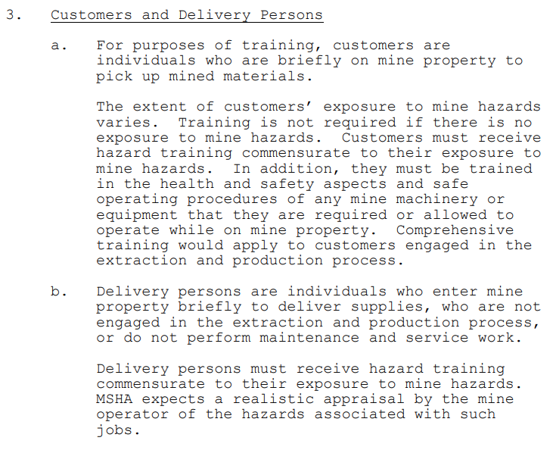
Customer Trucks / Drivers on Site
MSHA Program Policy Vol. III

Slide 33
Customer Trucks / Drivers on Site
Common Enforcement Issues
  Truck Drivers accessing top of loads
    Signage, signage, signage
    Designated tarping stations
    Enforcement of policy against drivers and driver companies
  Training
    Ensure contractors that require a training plan have one, follow it, and send trained miners
    Document completion of site-specific training and retain records

Slide 34
Best Practices with Contractors
Workplace and Pre-Shift Examinations:
Production-operators should ensure that contractors know they are required to perform workplace and pre-shift exams.
If production-operator employees are working in the same area as contractor employees, the operator must also complete a workplace exam.
Production-operator should ensure that contractor is performing workplace and pre-shift exams.
  If not the operator could be cited for failure to complete the exams.

Slide 35
Best Practices with Contractors
Walk-around rights
  Contractors have same right as production operator to accompany inspector, opening/closing conferences and receipt of citations
  Contractors should make this clear to production operator
  As supervisors not always on site with contractors, site personnel should be trained on accompanying and interacting with MSHA
  Citations should be provided to contractor, in the event they are not, check with production operator to see if the inspector left the citations
    Informal and Formal contest deadlines may begin from date of issuance, not date of receipt. This will not toll for contractors whose citations were left with production operator.

Slide 36
Best Practices
Outline duties/responsibilities of both production operator and contractor from the start
Ensure training/recordkeeping expectations are set
Review training program and completion of training for all persons coming on site
Enforce site work policy/procedures with regard to unsafe acts or violative conditions observed
Establish procedures for communication between operator and contractors

Slide 38
Check Out Our Blogs

Slide 39

Questions?

Slide 40

Contact Information
Nick Scala
Chair, MSHA • Workplace Safety Group
Conn Maciel Carey LLP
614.418.6048
nscala@connmaciel.com

