Slide 1
IAAP Annual Convention 2023
IDOT Policy Updates
Andrew Stolba, P.G.

Slide 2
Freeze Thaw Policy

Slide 3
Topics
Freeze Thaw Overview & Policy
Updates to Manual of Test Procedures
Recertification for Aggregate Technicians
IDOT Website Navigation
Questions

Slide 4
Sampling
Increase in sampling in 2021 and 2022 for Initial Series Freeze Thaw Approval.

Slide 5
2021 Freeze Thaw Data (303 Total Samples)
 | Number | % of all Samples | % of all Failures
Failures | 50 | 16.5 | 100.0
Natural Gravels | 11 (6 Round, 5 Partial Cr.) | 3.6 | 22.0
Initial Series Samples | 28 (20 were same material) | 9.2 | 56.0
“Annual” Samples | 17 | 5.6 | 34.0
Resamples | 5 | 1.7 | 10.0
Notes:
Of the 17 Annual Samples (15 had previous failures and 2 had borderline results)

Slide 6
2022 Freeze Thaw Data (333 Total Samples)
 | Number | % of all Samples | % of all Failures
Failures | 66 | 19.8 | 100.0
Natural Gravels | 22 (All Partial Cr.) | 6.6 | 33.3
Initial Series Samples | 50 (38 were same material) | 15.0 | 75.8
“Annual” Samples | 11 | 3.3 | 16.7
Resamples | 5 | 1.5 | 7.6
Notes:
Of the 11 Annual Samples (8 had previous failures and 3 had borderline results)

Slide 7
Freeze Thaw Policy
Notes:
Posted on the IDOT website under Aggregates.
Sampling frequency is base upon maximum expansion. (every 1, 2 or 3 years)
Initial Series of 5 or extended series of 10 for initial approval.

Slide 8
Freeze Thaw Timeline
Sample Received
Sample is taken by District personnel and delivered to CBM
Checked in and Assigned Group
Sample is checked in and assigned a Group Number based upon sample priority
Beam Cast and Cured for 14 Days
Sample is cast and cured for 14 days. After 14 days the first reading is taken on each of the 3 Freeze Thaw specimens
Testing in Freeze Thaw Chamber
Sample is placed in Freeze Thaw chamber and tested for 350 cycles. Measurements are taken every 50 cycles.
Expansion Monitoring
Expansions are monitored weekly. Any sample trending toward or failing before testing is complete is reported to the Districts.

Slide 9
Evaluating Failures
Freeze Thaw Failures will have cuttings made of the most expansive test specimen.
Evidence of D-Cracking must be present to remove a Source’s material from the QPL.
A Source’s history will be taken into consideration before removal.
A Site visit can be scheduled upon request.
Notes:
Posted on the IDOT website under Aggregates.

Slide 10
AGCS Update
Removing references to the AGCS Technician
Add a definition of Local Agency
Remove all hyperlinks in document
Section 4.2 changes Department QA/QC document to “Department document” and corrects reference to Appendix B.1 of the of the Manual of Test Procedures for Materials
Section 9.4 will reference to MISTIC is deleted and replaced with “Department’s materials management system”

Slide 11
Manual of Test Procedures for Materials Appendix Updates
Appendix A.2
Removing references to the AGCS Technician
Appendix A.3
Add definition for Critical Sieve

Slide 12
Lake Land College IDOT Quality Management Training Program (QMTP) Recertification

Slide 13
Recertification
Recertification for Aggregate Technician
Updated Plan - Will be phased in over 5-year period
Required every 5 years
Written exam
One Failure –> Retest
Two Failures -> Retake full course
Optional Online Review Materials
Test Sites - Mattoon & Thornton
Considering additional test sites after 1st year for non-lab proficiency courses

Slide 14
Recertification Phases
Phase 1 (2023-2024 Training Season)
Individuals with certification dates from 1992-1999
Phase 2 (2024-2025 Training Season)
Individuals with certification dates from 2000-2006
Phase 3 (2025-2026 Training Season)
Individuals with certification dates from 2007-2012
Phase 4 (2026-2027 Training Season)
Individuals with certification dates from 2013-2018
Phase 5 (2027-2028 Training Season)
Individuals with certification dates from 2019-2023

Slide 15
Lake Land College QMTP Recertification
QMTP General Website
https://learn.lakelandcollege.edu/IDOT/index.jsp
QMTP Recertification FAQ’s Website
https://learn.lakelandcollege.edu/IDOT/faq-recertification.jsp
Training database was sent to Materials Associations and IDOT Districts in November Recertification Online Registration is Live

Slide 16
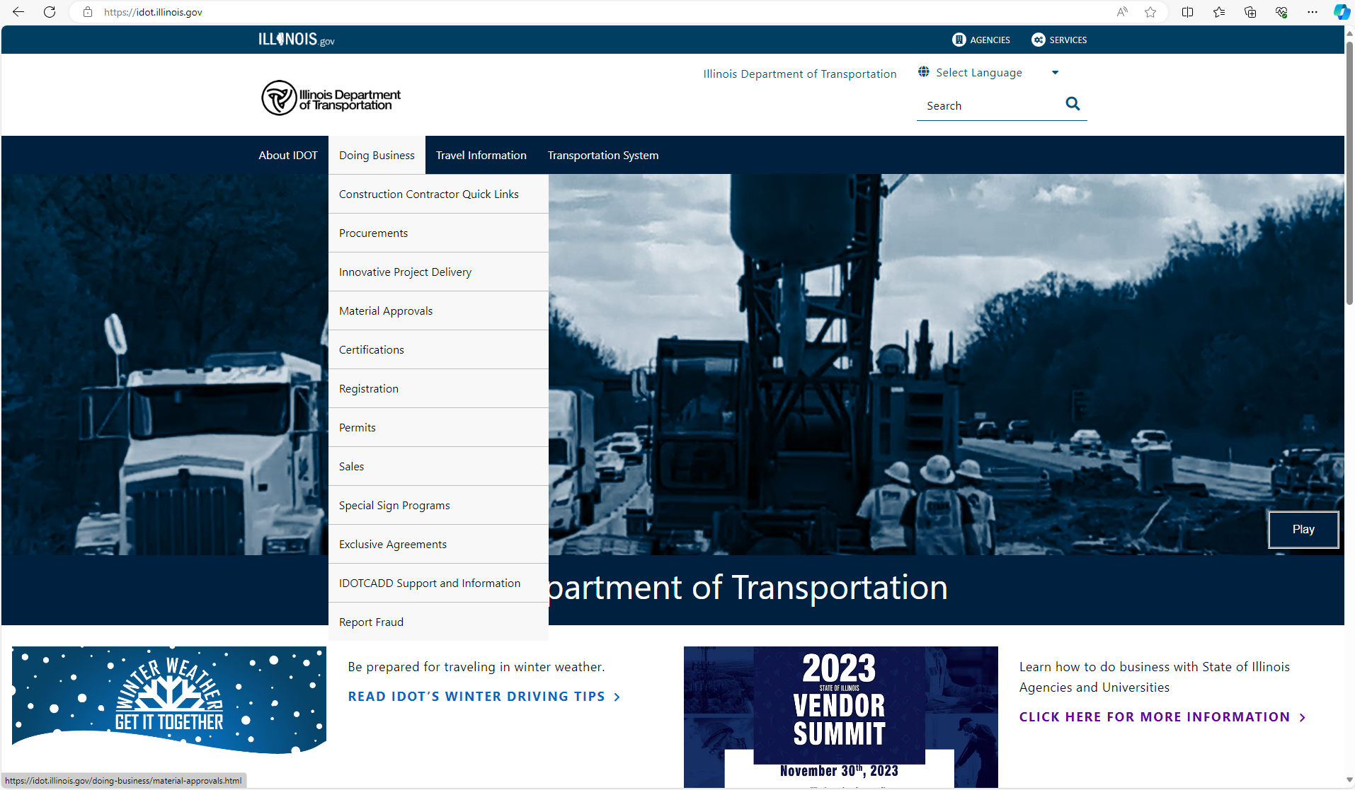

Slide 17
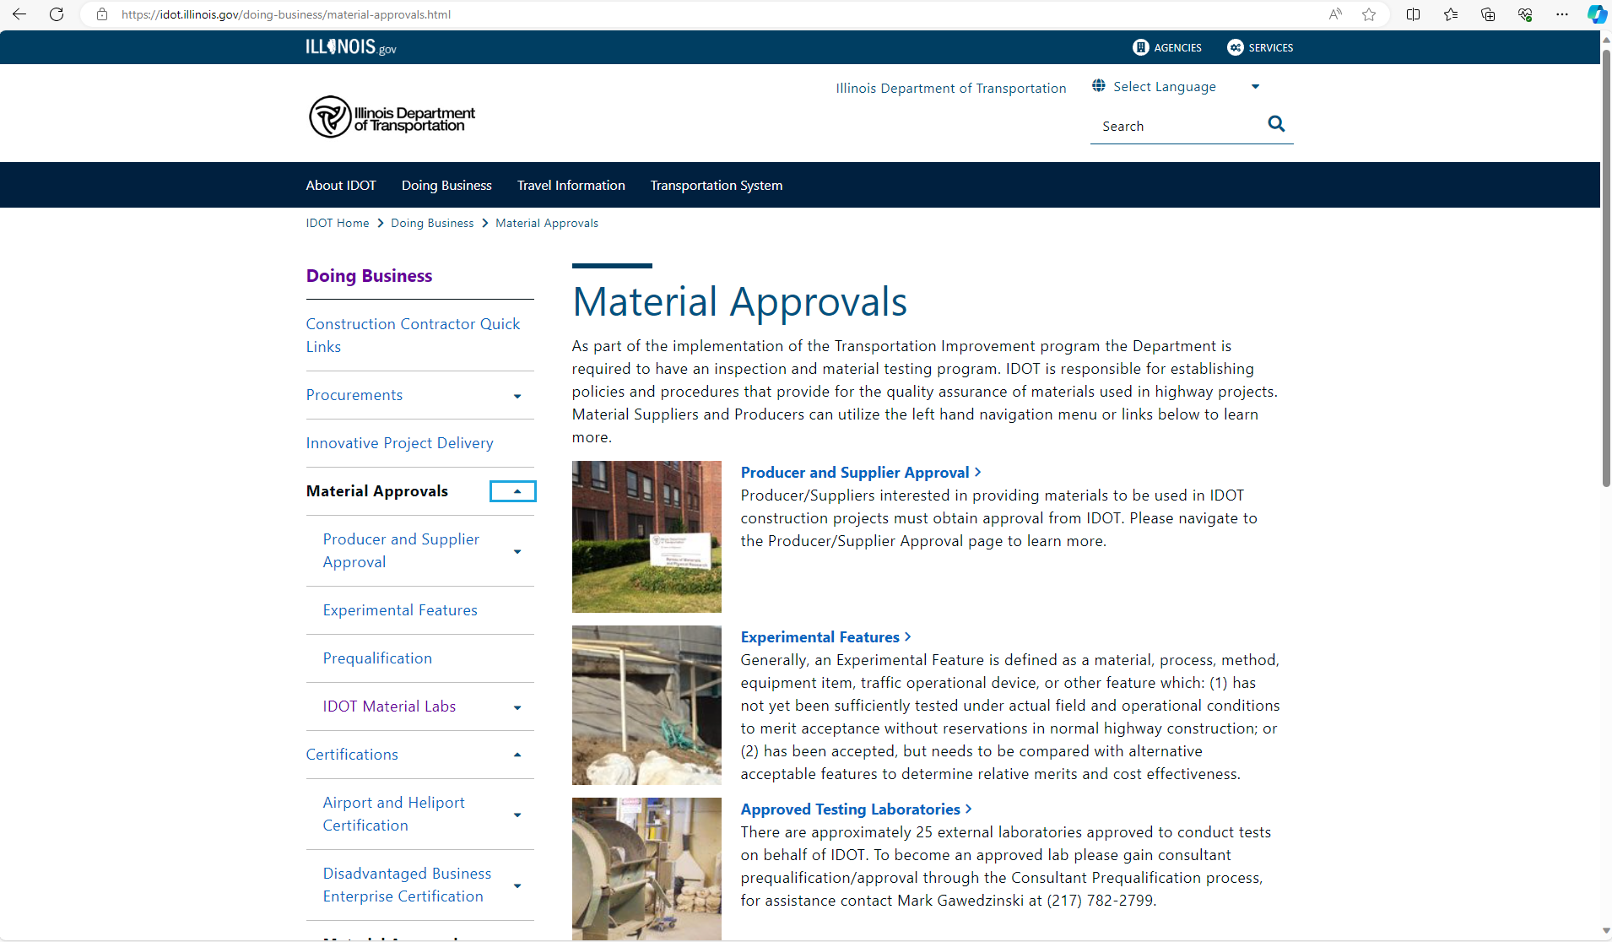

Slide 18
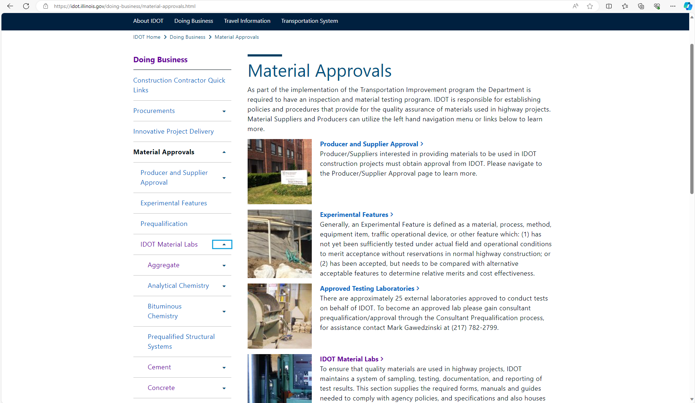

Slide 19
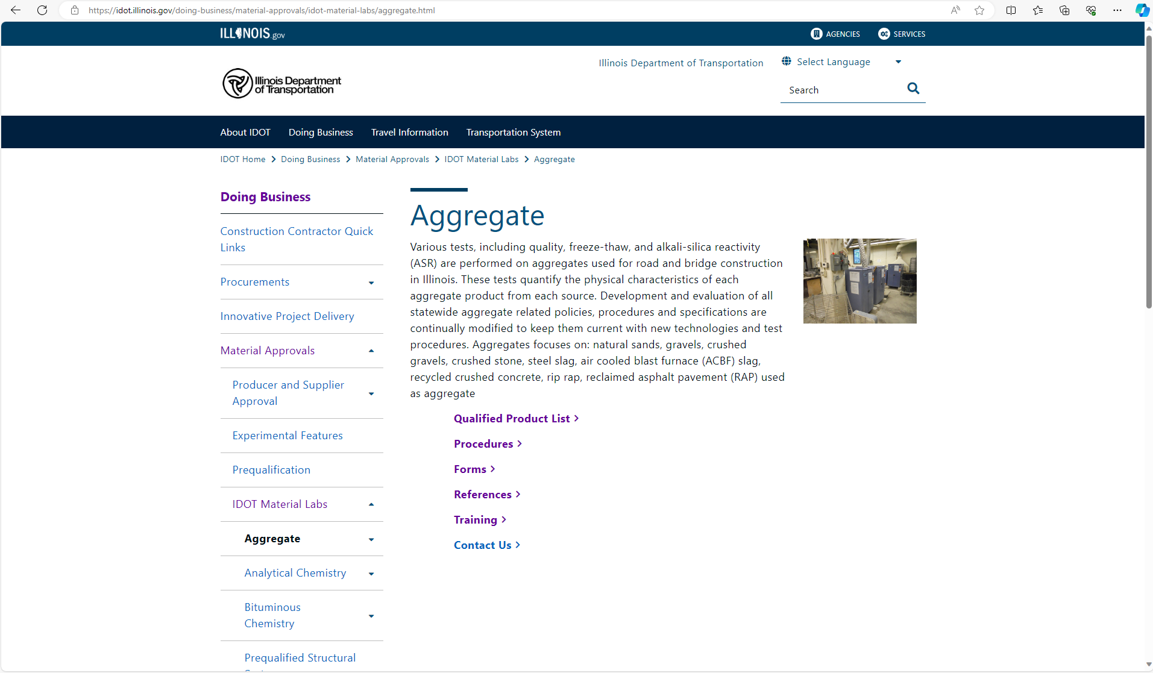

Slide 20
Questions...

