Slide 1
Developing EPD’s For Aggregates
John J Yzenas Jr
john@jyc-consulting.net
jyzenas@nssga.org

Slide 2
Agenda
What is a PCR / EPD?
Why does the Aggregate Industry need them?
  FHWA
  State Legislation
  Federal Legislation
  Paving Industry
Construction Aggregate PCR 2023
EPD Tool
  Site / Product Specific
  Availability
    Cost

Slide 3
Product Category Rule (PCR)
​A PCR is a set of product category-specific requirements / rules / guidelines for developing life cycle assessment and reporting these findings in an Environmental Product Declaration for one or more product categories. Product category rules are reviewed and improved periodically over time (5-years).
Product Category Rule (PCR) development can be sponsored by a group of stakeholders, including associations, manufacturers, or other interested parties.
While PCRs must be prepared in accordance with the requirements set forth in ISO 14025, additional work may be needed to improve harmonization. PCRs for construction products must additionally comply with ISO 21930.
Copies of the ISO standards can be downloaded from ANSI: http://www.webstore.ansi.org.

Slide 4
Environmental Product Declaration (EPD)
A verified report used to communicate the environmental impacts of a specific material (e.g., asphalt binder, portland cement) or product (e.g., asphalt mix, concrete mix).
EPDs promote more sustainable use of finite resources and create less stress on the environment.
EPDs are a life-cycle assessment developed by product manufacturers following the Product Category Rules (PCR) that are developed with industry stakeholders and LCA experts and subjected to a critical review process.
EPDs can be issued for a specific product from a specific producer but may also be issued for a generic product from a group of manufacturers (such as an association) that reflects the results of an industry-average LCA.
EPDs using the same product category rules can be compared to identify materials with improved environmental performance in terms of various environmental and resource use impacts (e.g., energy use, air pollution, global warming, ozone layer depletion).
https://www.fhwa.dot.gov/pavement/sustainability/pubs/hif19027.pdf

Slide 5
Current Legislation
Year introduced | Source | Bill
2017 | California Legislature | Buy Clean California Act
2019 | Minnesota Legislature | HF 2204
2020 | New York State Senate | S542 (Original)
2021 | California Legislature | AB-1365, SB-778
2021 | Colorado State Assembly | HB 21-1303
2021 | Oregon State Legislature | HB 2688
2021 | New Jersey Assembly | AB 5223
2021 | Washington State Legislature | HB 1103
2021 | House of Representatives, 117th Congress | H.R.1512 CLEAN Future Act – Subtitle C – Federal Buy Clean Program
2022 | GSA | Inflation Reduction Act

Slide 6
State / Federal Procurement Policy
Carbon Leadership Forum
Notes:
DOT Projects

Slide 7
FHWA: Sustainable Pavements Group
Actively Promoting the utilization of EPD’s
  Asphalt Pavement (NAPA)
  Cement (PCA)
    Slag Cement (SCA)
  Concrete Pavement (NRMCA)
  Construction Aggregates (NSSGA)
Developing best practice guidelines for PCR’s to facilitate harmonization.
FHWA LCA Development Program

Slide 8
Asphalt LCA product system
FHWA

Slide 9
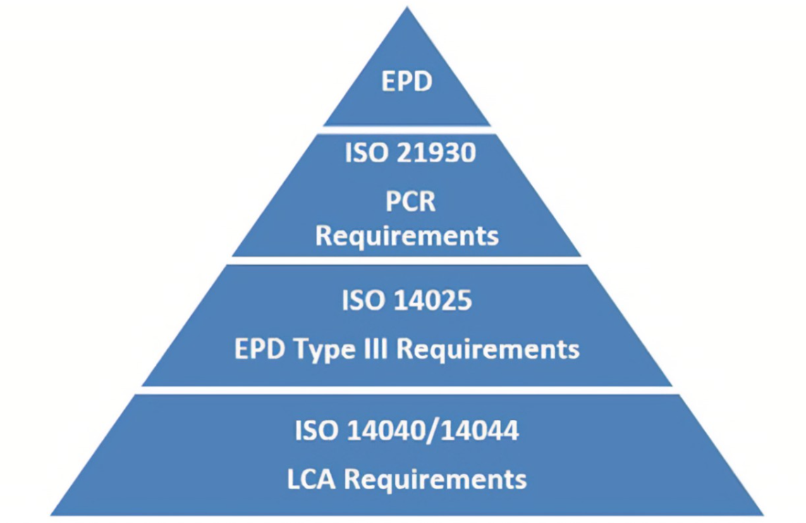
PCR’s and ISO
ISO
International Standards
Organization

Slide 10
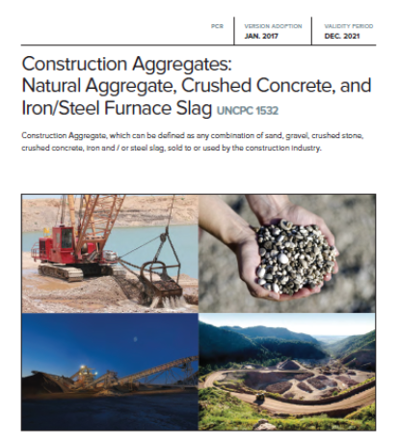
Construction Aggregates PCR
Original –
  Program Operator: ASTM
  Adopted Jan. 2017
  Valid to Dec 2022 (extended)
Current –
  Program Operator: National Science Foundation (NSF)
Construction Aggregate, which can be defined as any combination of sand, gravel, crushed stone, crushed concrete, iron and/or steel slag sold to or used by the construction industry.

Slide 11
Differences
2017 (Version 1) vs 2023 (Version 2)
The PCR has been renewed and updated to include conformance with ISO 21930 (2017).
Unbound asphalt is included in Version 2 of this PCR.
The title of the PCR has been modified to “PCR for Construction Aggregates”.
This PCR has been updated to include specific information on upstream data included in Annex A.
An underlying LCA has been completed to complement this PCR.

Slide 12
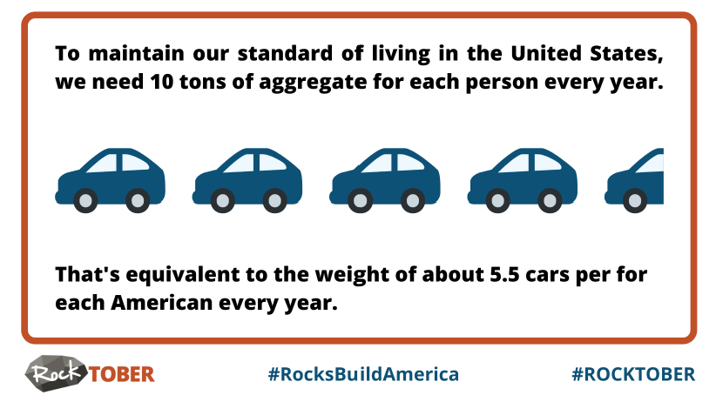

Construction Aggregates?
Stone, sand and gravel – Crushed and/or processed
Slag aggregate
RAP aggregate (new)
Broken concrete aggregate (aka crushed concrete)

Slide 13

Status of 2023 PCR
Committee started meeting May 2021
Draft completed 9/26/2022
Sent to expert review COB Oct 2022
Tech review comments received, response issued early Feb 2023
Public comment May 2023
PCR committee vote June 2023
Best guess…..Pending NSF Publishing
Current PCR expired 12/31/22 – NSF extension

Slide 14
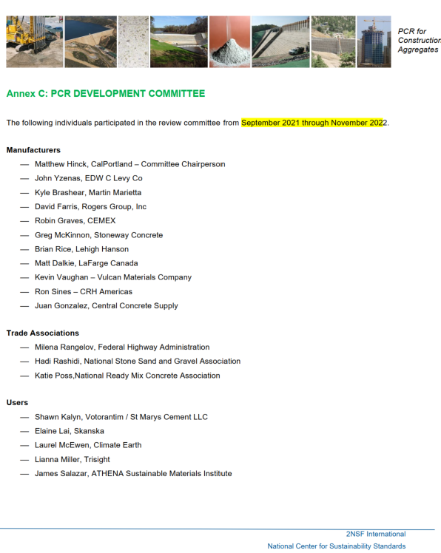
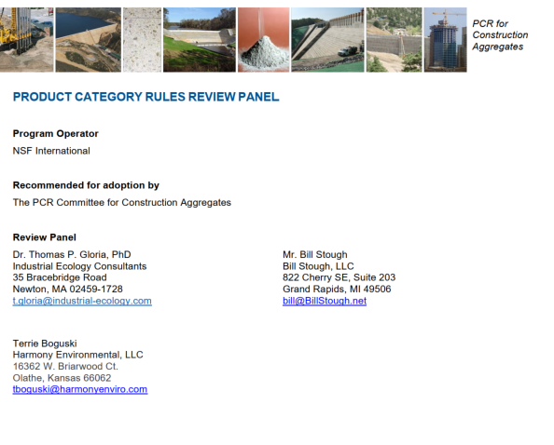
Committee / Reviewers

Slide 15
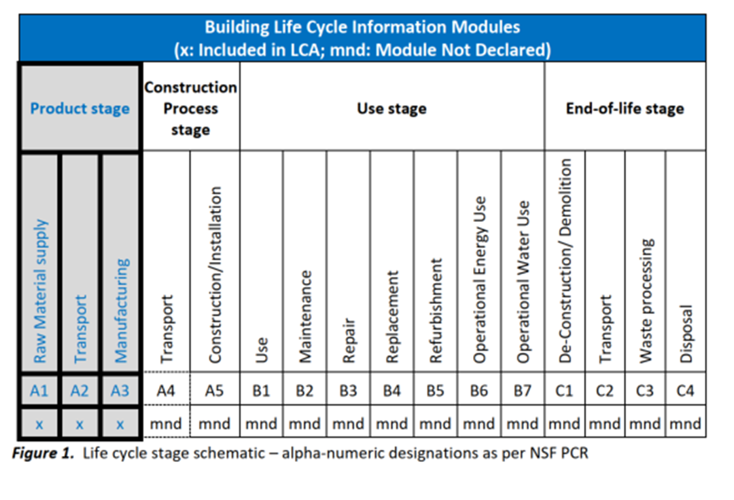
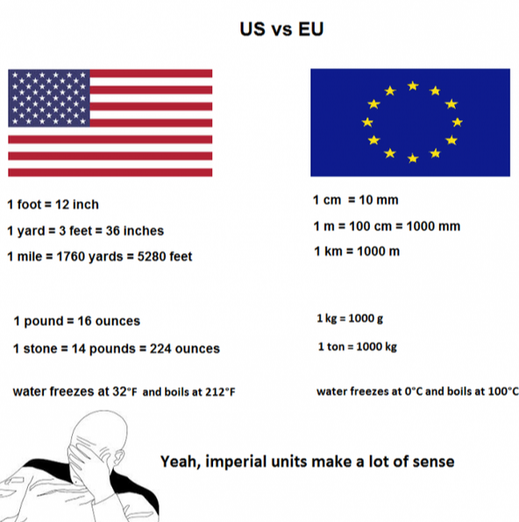
Key Decisions
Basis
Scope A1 to A3
One English ton – 2000 lbs.
Conversion factors provided to metric
Weight is on an as-is (wet basis)

Slide 16
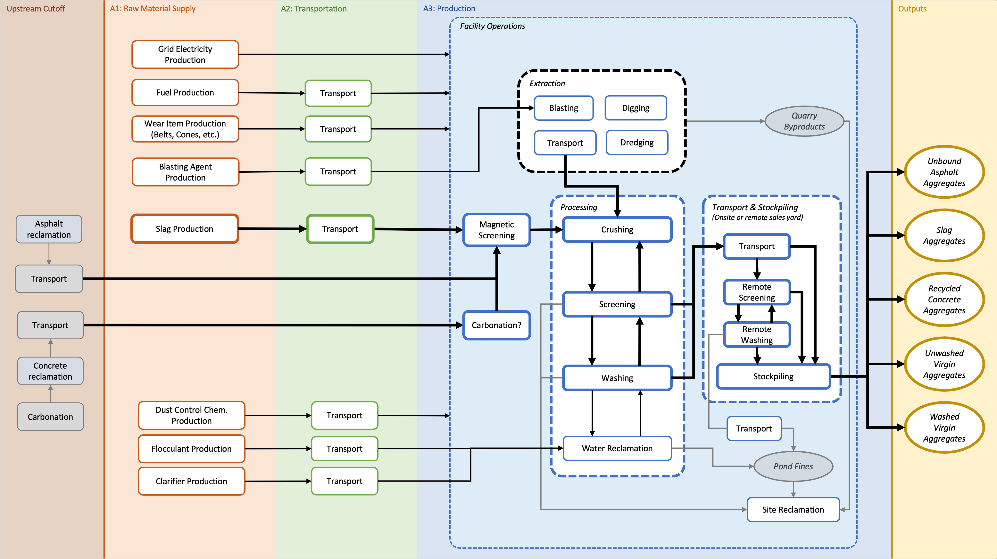
Cutoff Boundaries

Slide 17
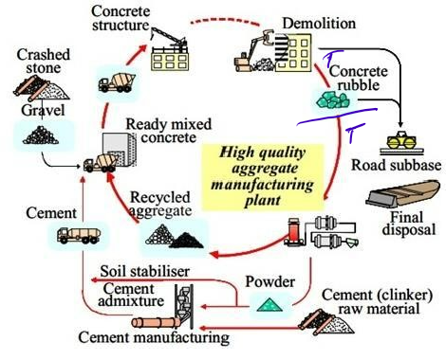
Cut off Boundaries (Concrete and RAP)
7.1.6 – “All EDP related burdens from the initial RAP and broken concrete piles onward are accounted for in the aggregates PCR..”
7.2.5.2 -Slag allocation is economic

Slide 18
Upstream Data
Annex A
Conforms to ACLCA Guidance for PCR
  aclca.org/pcr/
Specification of upstream data sources – publicly available*
First construction PCR to adopt ACLCA guidance on upstream data
Goal is quality data in EPD’s and to be consistent across construction materials

Slide 19
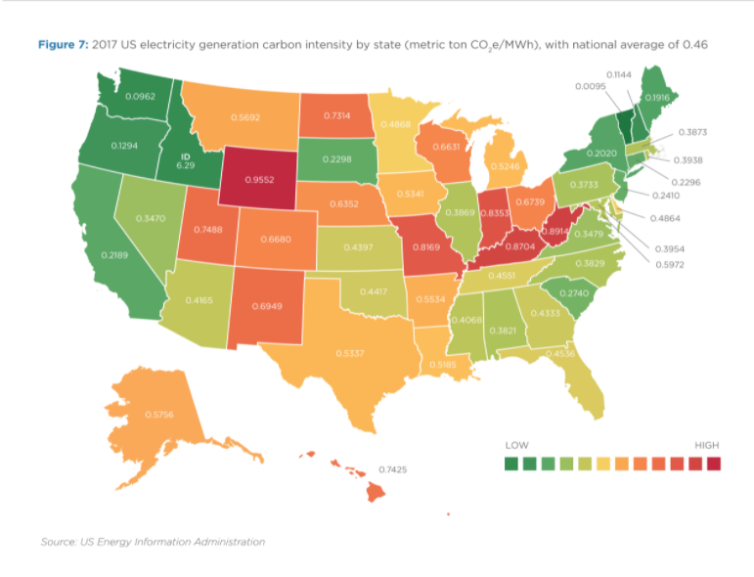
Example – Upstream data

Slide 20
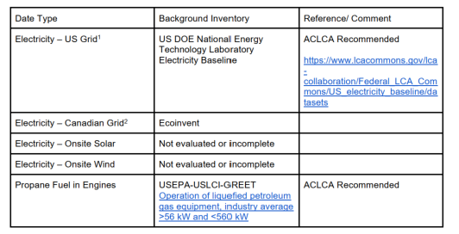
Example – from Agg PCR Annex A

Slide 21
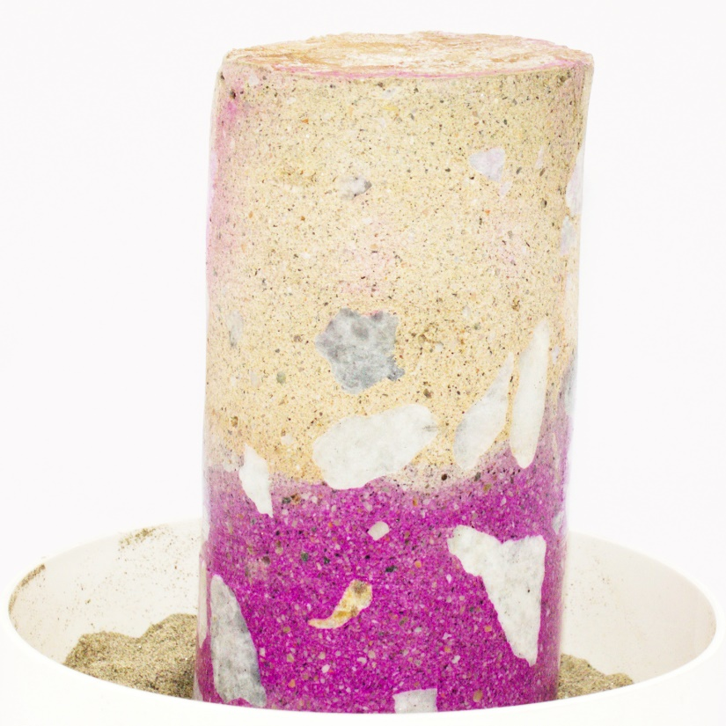
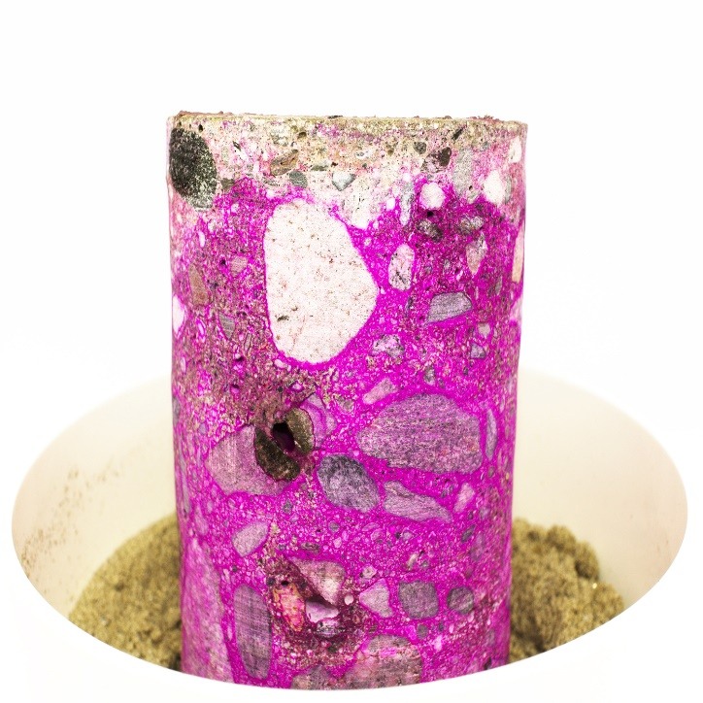
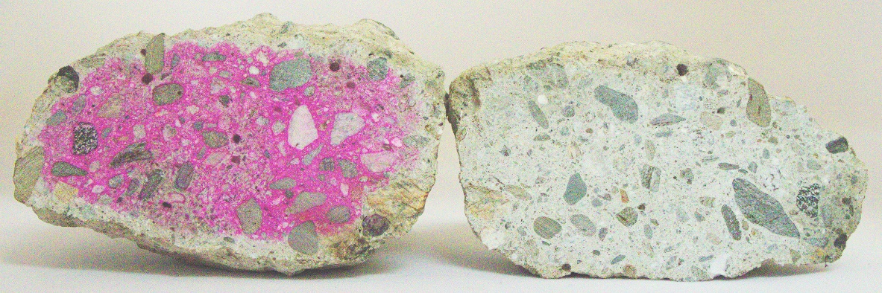
Carbonation
Notes:
Carbonation happens
Examined 100 year old concrete at the Colton site and found carbonation happens. Light layer is were this piece has carbonated.
Even after demolition. Concrete is crushed and still continues to carbonate.
Concrete is sucking it’s carbon dioxide back out of the air.

Slide 22
Carbonation
Calculated carbonation benefits can be provided in EPD’s as part of “supplemental environmental information”. Not calculated as part of A1-A3.
Annex B
3 calculation methods
  1. apply factor of -0.35 kg CO2e/ton
  2. GCCA tool for Concrete and Cement V 3.1
  3. Quantify through field sampling and lab testing

Slide 23
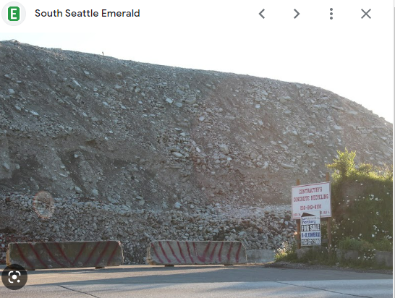
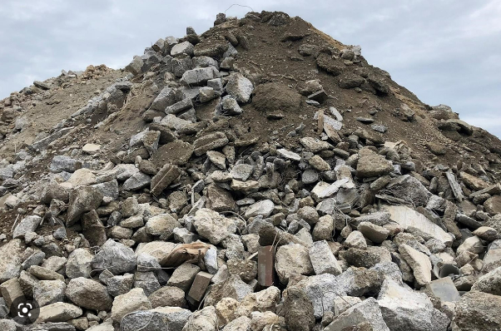
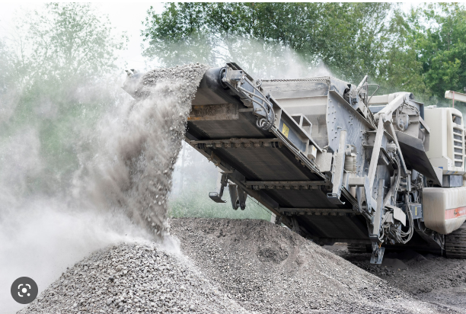
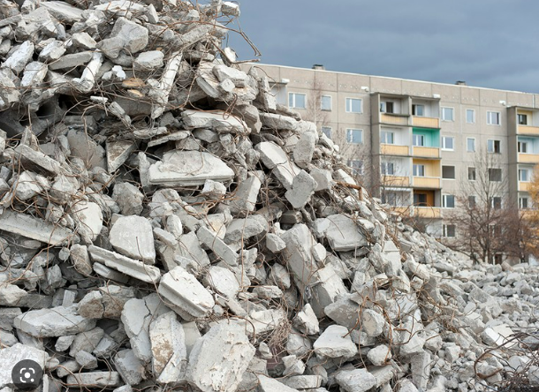
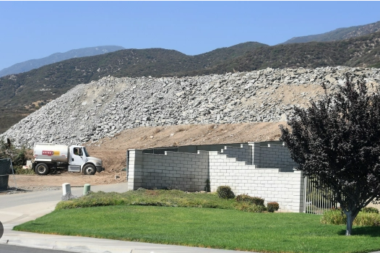
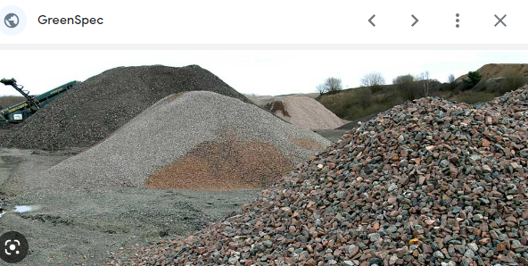
Issues

Slide 24
Underlying LCA
A deep dive into construction aggregate environmental impacts…the highlight reel.

Slide 25
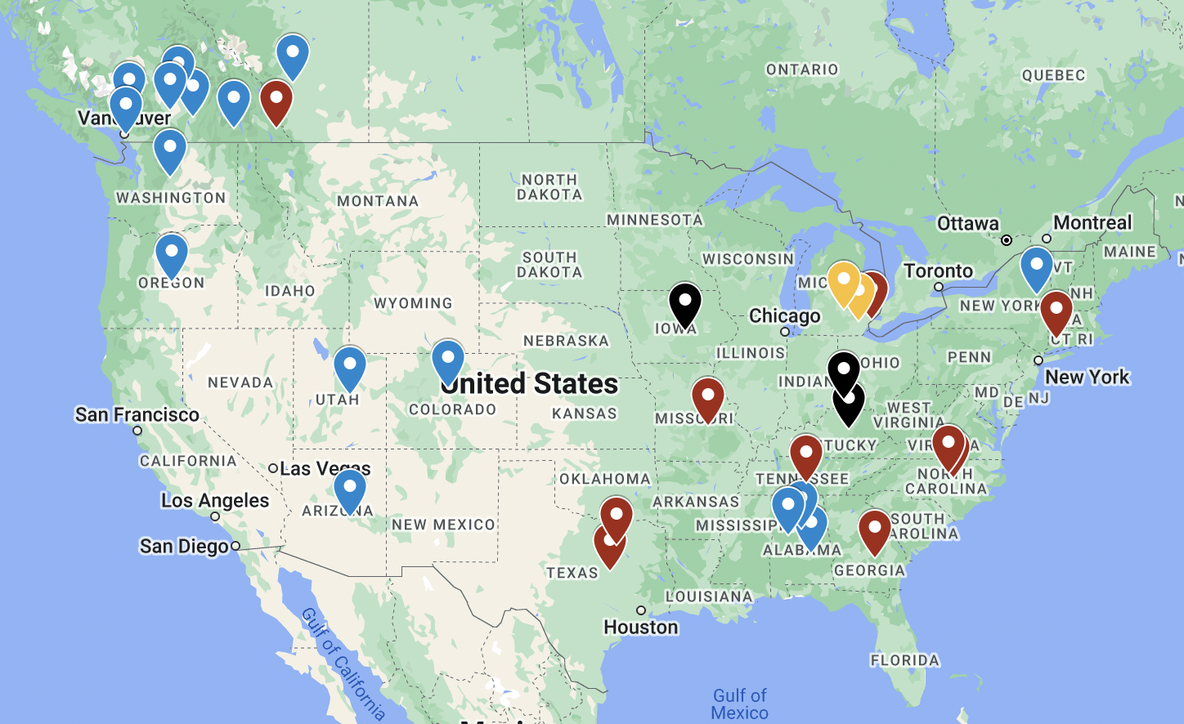
Approximate Location
Type of Participating Facilities

Slide 26
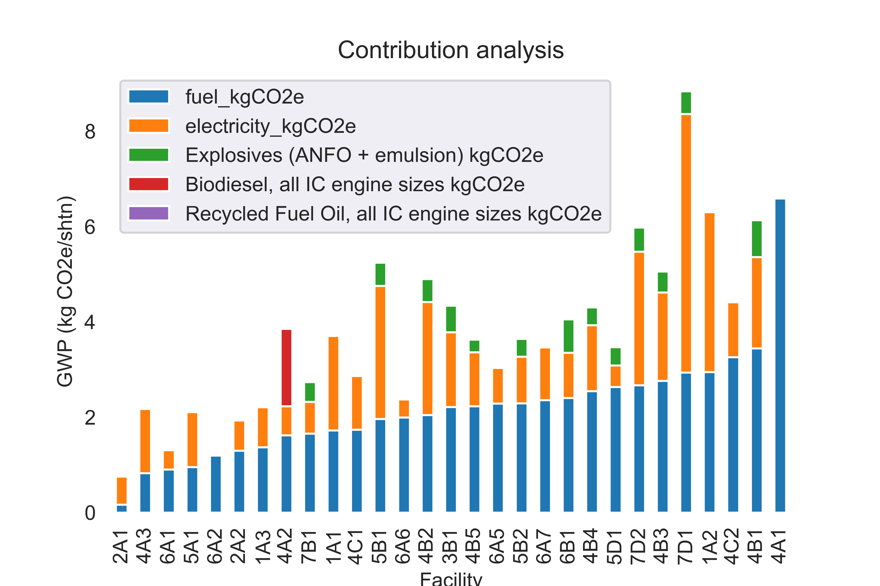
Diesel, Electricity, and Explosives
The Major GWP Contributors

Slide 27
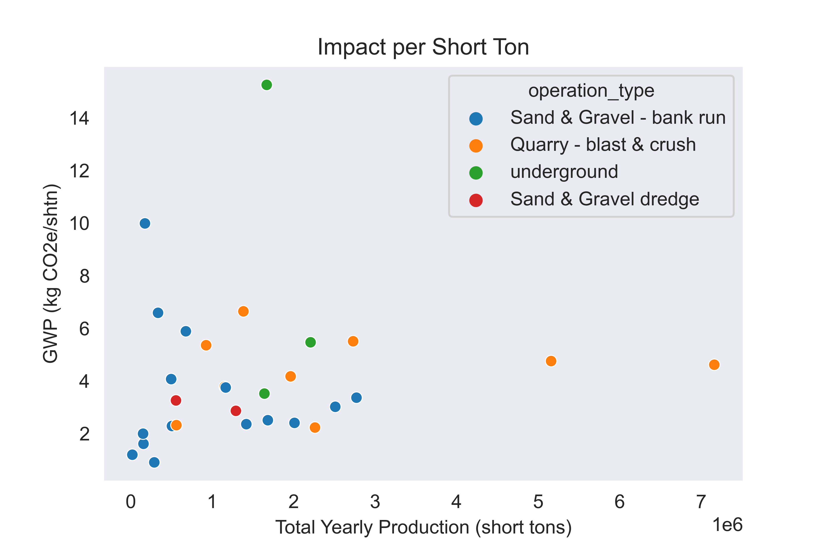
Operation Type

Slide 28
Facts
Aggregates are low CO2e products. 3 to 8 kg/ton
How does this impact Concrete/Asphalt?
  Concrete EPD 300 kg CO2e/Yd. 1.5 tons aggregate = ~6 kg CO2e/Yd of concrete or 2%.
  Asphalt – Standard mix 50 kg CO2e/Ton. Agg at 0.95 ton agg/ton asphalt = ~4 kg CO2e/ton or 8%
    Substitute RAP and reduce GHG even further
  LCA commons value for Aggregate is 1.7 kg CO2e/ton
    Used by LCA practitioners
  Update LCA data - What is EPA going to do with all that money from the IRA???

Slide 29
Transportation
Transportation of aggregate matters
  4 kg CO2e/ton to truck aggregate 15 miles
  0.8 kg/CO2e/ton by barge for same distance
How does this impact Aggregate EPD?
How does this impact asphalt, concrete EPD’s?
Keep in mind EPD’s are Cradle to Gate….

Slide 30
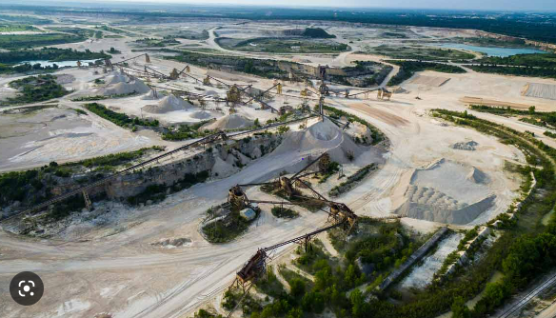
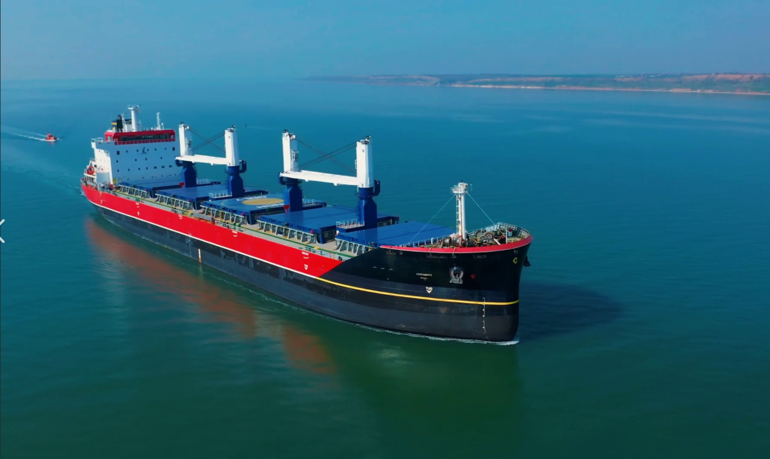
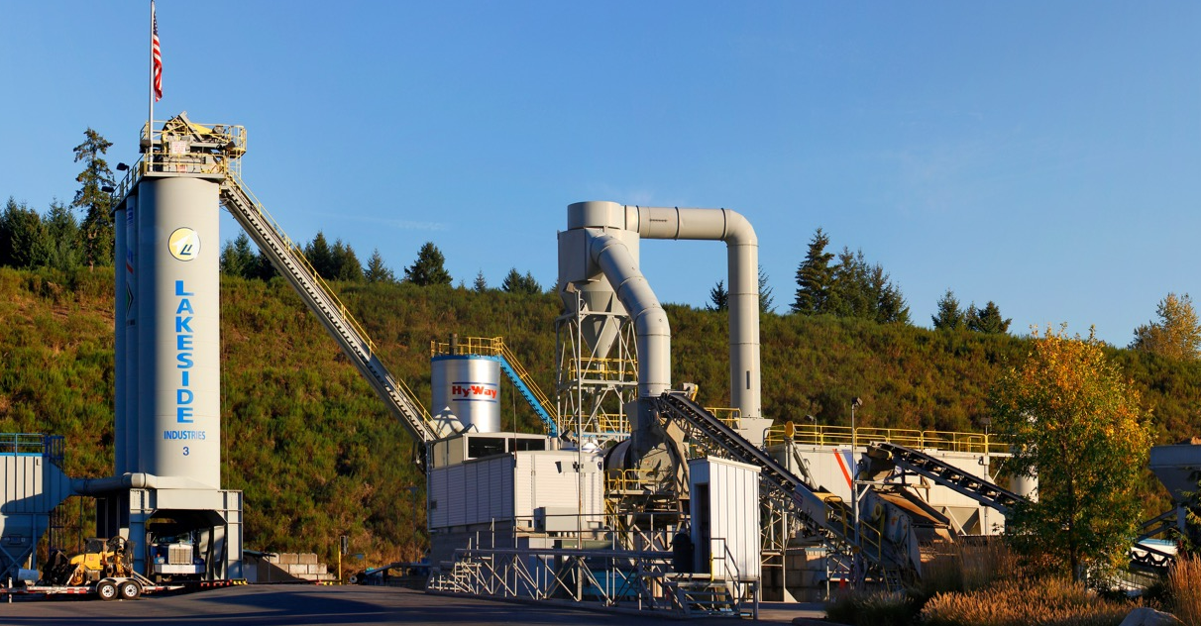
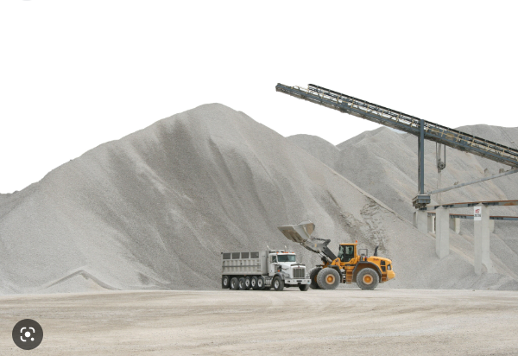
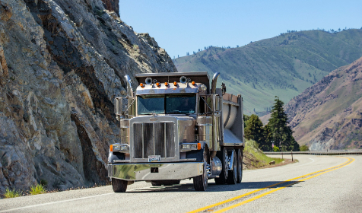
Remote Supplier
Ocean Transport
Local Supplier

Slide 31
Other PCR’s
Asphalt - Just completed. Will be Valid through 2027
Concrete PCR – Valid through Feb 22, 2024
Cement PCR - Valid through March 31, 2025
Aggregates PCR – Final ~ 2023

Slide 32
The EPD Ecosystem
Binder EPDs
Aggregate EPDs
Cement EPDs
Asphalt Mix EPDs
Concrete Mix EPDs
DOT
Database
3rd Party
Databases
Constr.
Mgmt
Software
Procurement Decisions

Slide 33

EPDs for Construction Aggregates
Coming soon:

Slide 34

What is ?
Facility-specific EPDs
Preferential pricing for NSSGA Members
Streamlined data entry
Fast verification
Traditional and digital EPDs

Slide 35
What you need to know and provide?
Plant type
Feedstock type or geology
Operation type (blasting, dredging, …)
Secondary processing/stockpiling locations
Grid energy use
Fuel use (diesel, natural gas, …)
Consumable inputs: flocculant, dust control

Slide 36
Overall & Administrative Data
Data gathering period
Total Annual Production in short tons (not sales)
Operation type
Primary geology
Are your extraction and processing done in separate locations? That is, material is transported more than one mile by rail, truck or barge to processing? And finally, is the processing location treated as a separate area, with different tracking of electricitiy, fuel use, etc?
Do you have a secondary stockpile that tracks its electricity, water use, etc, separate from your main facility?
If you said yes to line 20 or line 21, what is the form(s) of transport and mileage between locations?
How many screens do you regularly have in use?
How many crushers do you regularly have in use?

Slide 37
Inputs: Energy
Is your aggregate operation co-located with one or more other facilities (like an asphalt or concrete plant)? Do not include facilities that are leased, only those owned or operated by your quarry.
Do you have separate electrical metering for your aggregate facility?
If no, please enter your most informed estimate of the percent of electiricty used in the aggregate operation and your confidence in that estimate. Example: 75% electiricity used in aggegate ops, 60% confident in that estimate
Do you purchase renewable energy certificates or participate in an offsite renewable energy program? If so, please describe your REC or offsite renewables program.
Energy Source
Electricity, from Grid: kWh/yr
Electricity, from onsite solar: kWh/yr
Electricity, from onsite wind: kWh/yr

Slide 38
Fuels (gallons / MCF)
Natural gas
Propane
Diesel
Gasoline
Recycled Fuel Oil
Residual Fuel Oil
Renewable Natural Gas (RNG)
Biodiesel
Biodiesel type (e.g. B20, B80, etc.)
Do you use any other fuels? List their types and quantity used here.

Slide 39
Water (gallons / sq. ft.)
Water: Do you meter or otherwise track your water use? (if no, please use your best estimates for the following questions about water use)
Total water use
Water use for dust control
Water use for washing
Water source, well water
Water source, municipal water
Water source, ponds (including settling ponds)
Total surface area of ponds
What percent of your water is recycled?
If these water numbers are estimates, what is your confidence in your estimate?

Slide 40
Other Consumables (lbs. / gallons)
Wear parts: Not all wear parts are needed for this calculation.
Provide just the following:
  Blasting agents (combine all types)
  Flocculants
  Dust control additives

Slide 41
Recycled Concrete Aggregates (tpy)
Do you produce any recycled concrete aggregate (RCA)?
How many tons of RCA did you produce during the data gathering period?
How many tons of RCA did you receive during the period?
How many times did you receive RCA during the period?
How tall are your RCA stockpile(s)? If it changes often, give your best estimate for average height
On average, how old is your RCA stockpile?
Do you have a maximum target size for your RCA stockpile(s)?
Is your stockpile a typical cone shape, or do you manipulate it to another shape (e.g. spread out until X feet tall)
About what size is the RCA in your stockpiles?

Slide 42
Production / End of Life
List the aggregates you produced & sold in your reporting year, in short tons.
Please add your products until you have accounted for all of your production / sales in your reporting year
How long has this quarry been in operation?
From the ranges given, about how long do you expect this quarry to continue to operate?
Do you have a quarry reclamation plan?
If so, what general category does it fit into?
(example) Landscaping boulders
(example) Cobbles
(example) 3/4"
(example) 1/2"
(example) 3/4" washed
(example) 1/2" washed
(example) Fine #2

Slide 43
Sensitive information
All proprietary operational data is protected
Only final performance metrics are public
You choose which EPDs get published

Slide 44
Workflow
Data collection
(excel)
Create Theta account
Available today!
Define your facilities
Define your products
Create EPDs

Slide 45
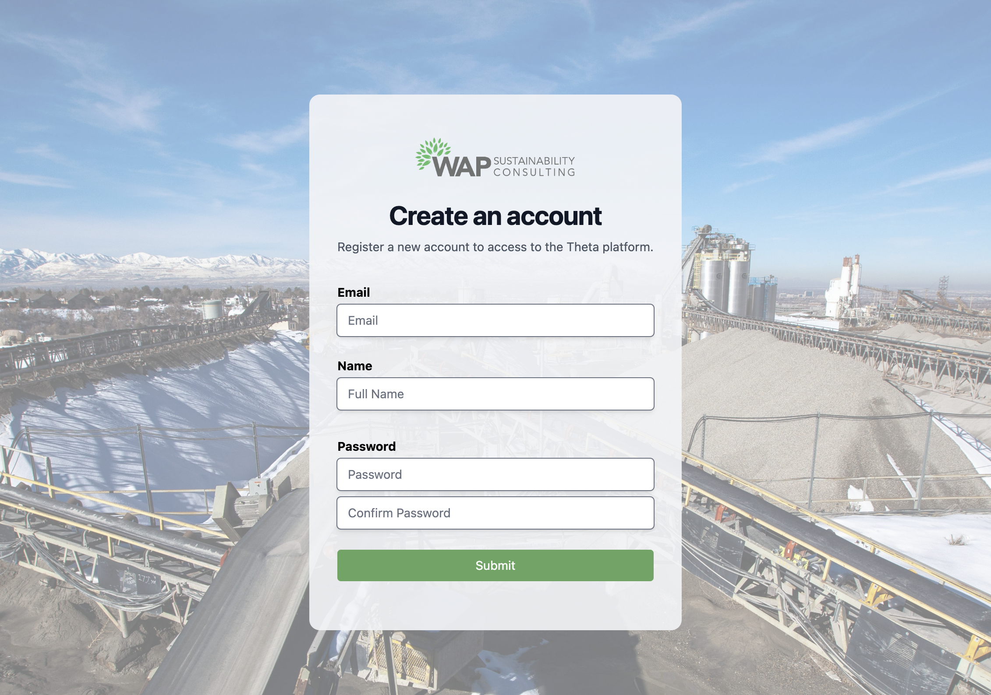
Create an Account

Slide 46
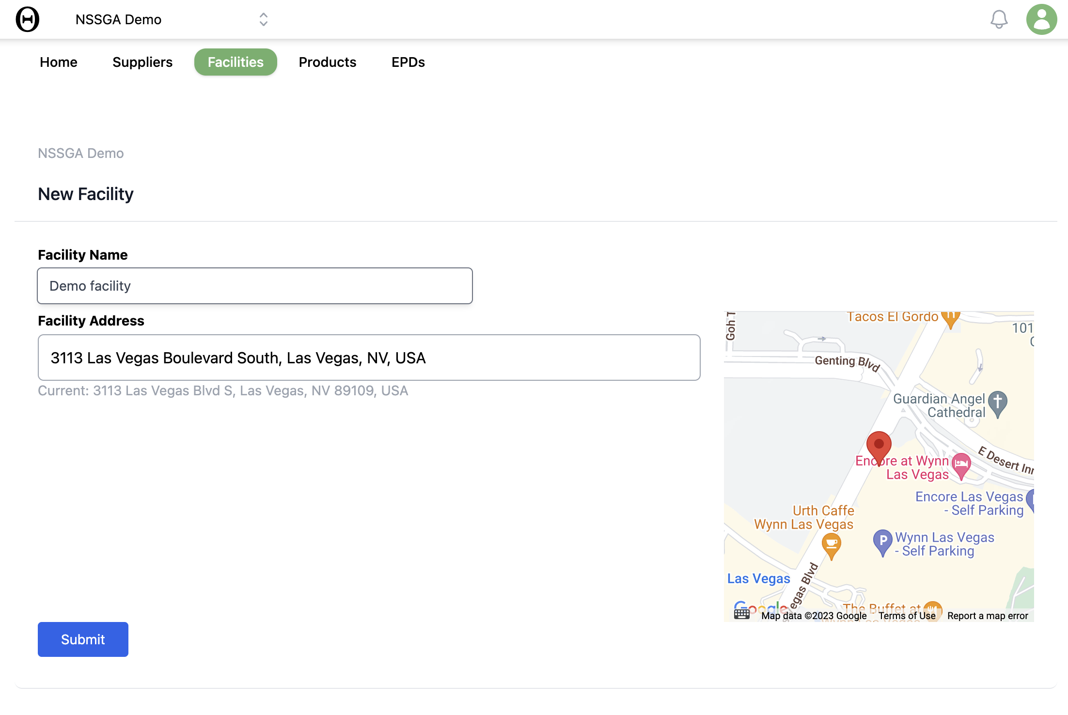
Define Facility

Slide 47
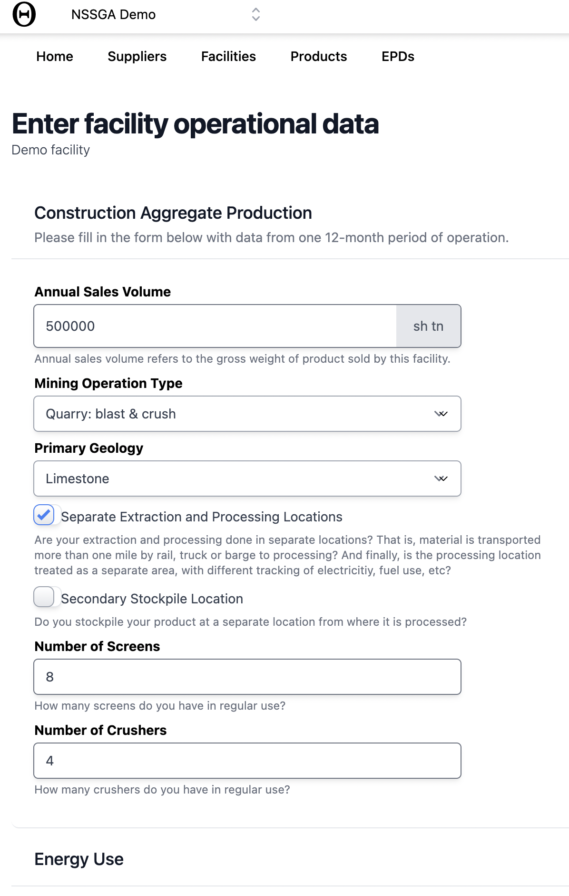
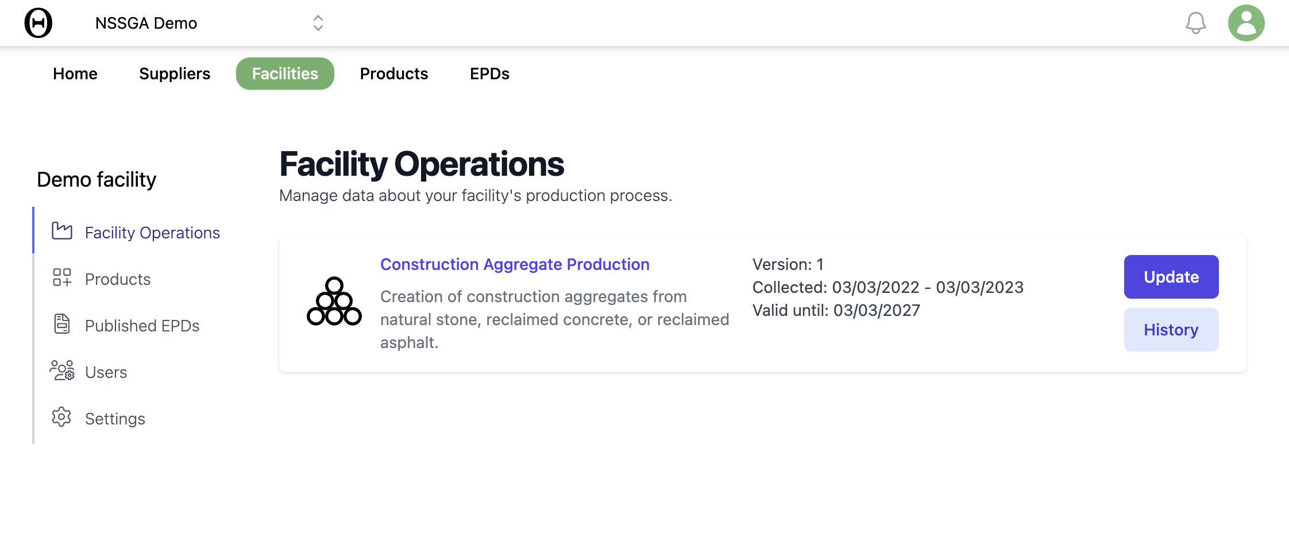
Facility Data

Slide 48
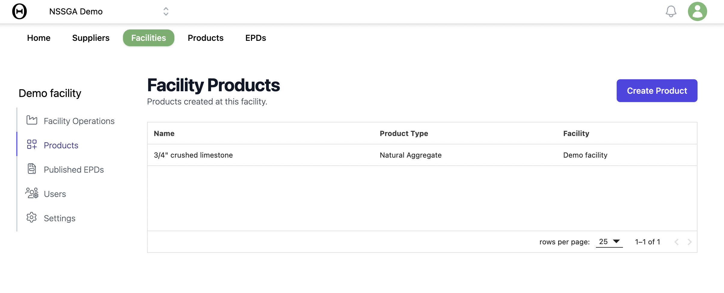
Products

Slide 49
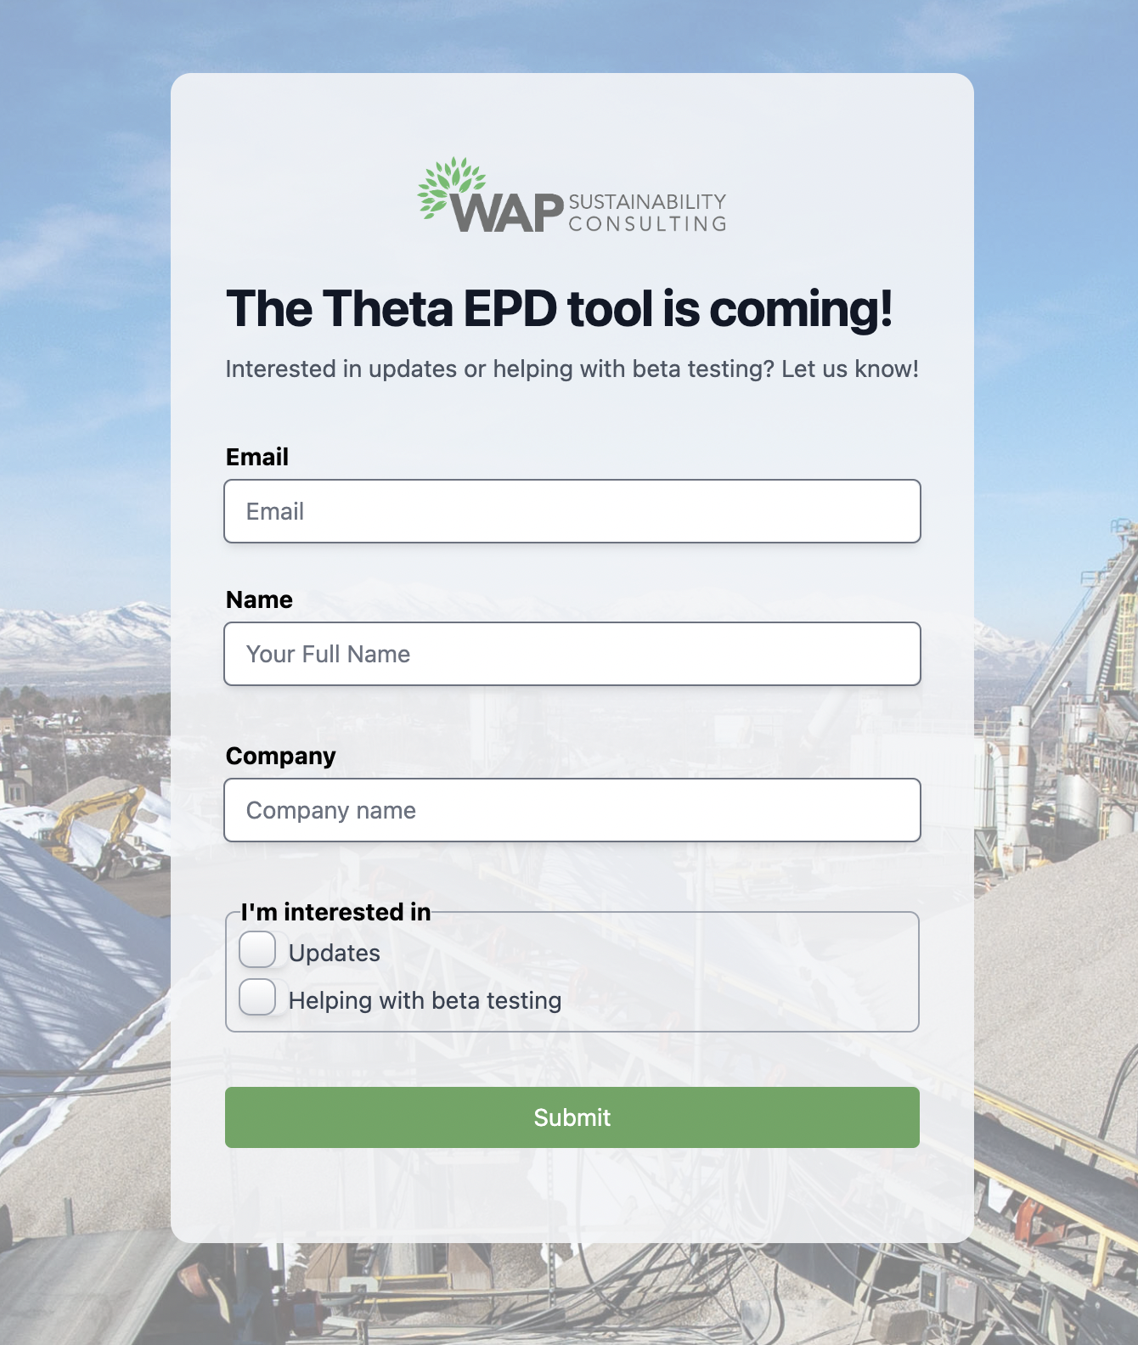
Timeline and What to Expect
Driven by PCR process: Soon
Register beta interest: underway
Beta testing: in process
Launch: when the PCR is published
Sign up for beta testing at
www.AggregateEpd.com

Slide 50
Thank You! Questions?
Contributors:
John Yzenas Matt Hinck Ben Ciavola
jyzenas@nssga.org mhinck@calportland.com ben@wapsustainability.com

