Slide 1
2023 ILLINOIS ASSOCIATION OF AGGREGATE PRODUCERS ILLINOIS TOLLWAY POLICY SEMINAR
Cindy Williams Deputy Chief of Program Implementation
December 5, 2023

Slide 2
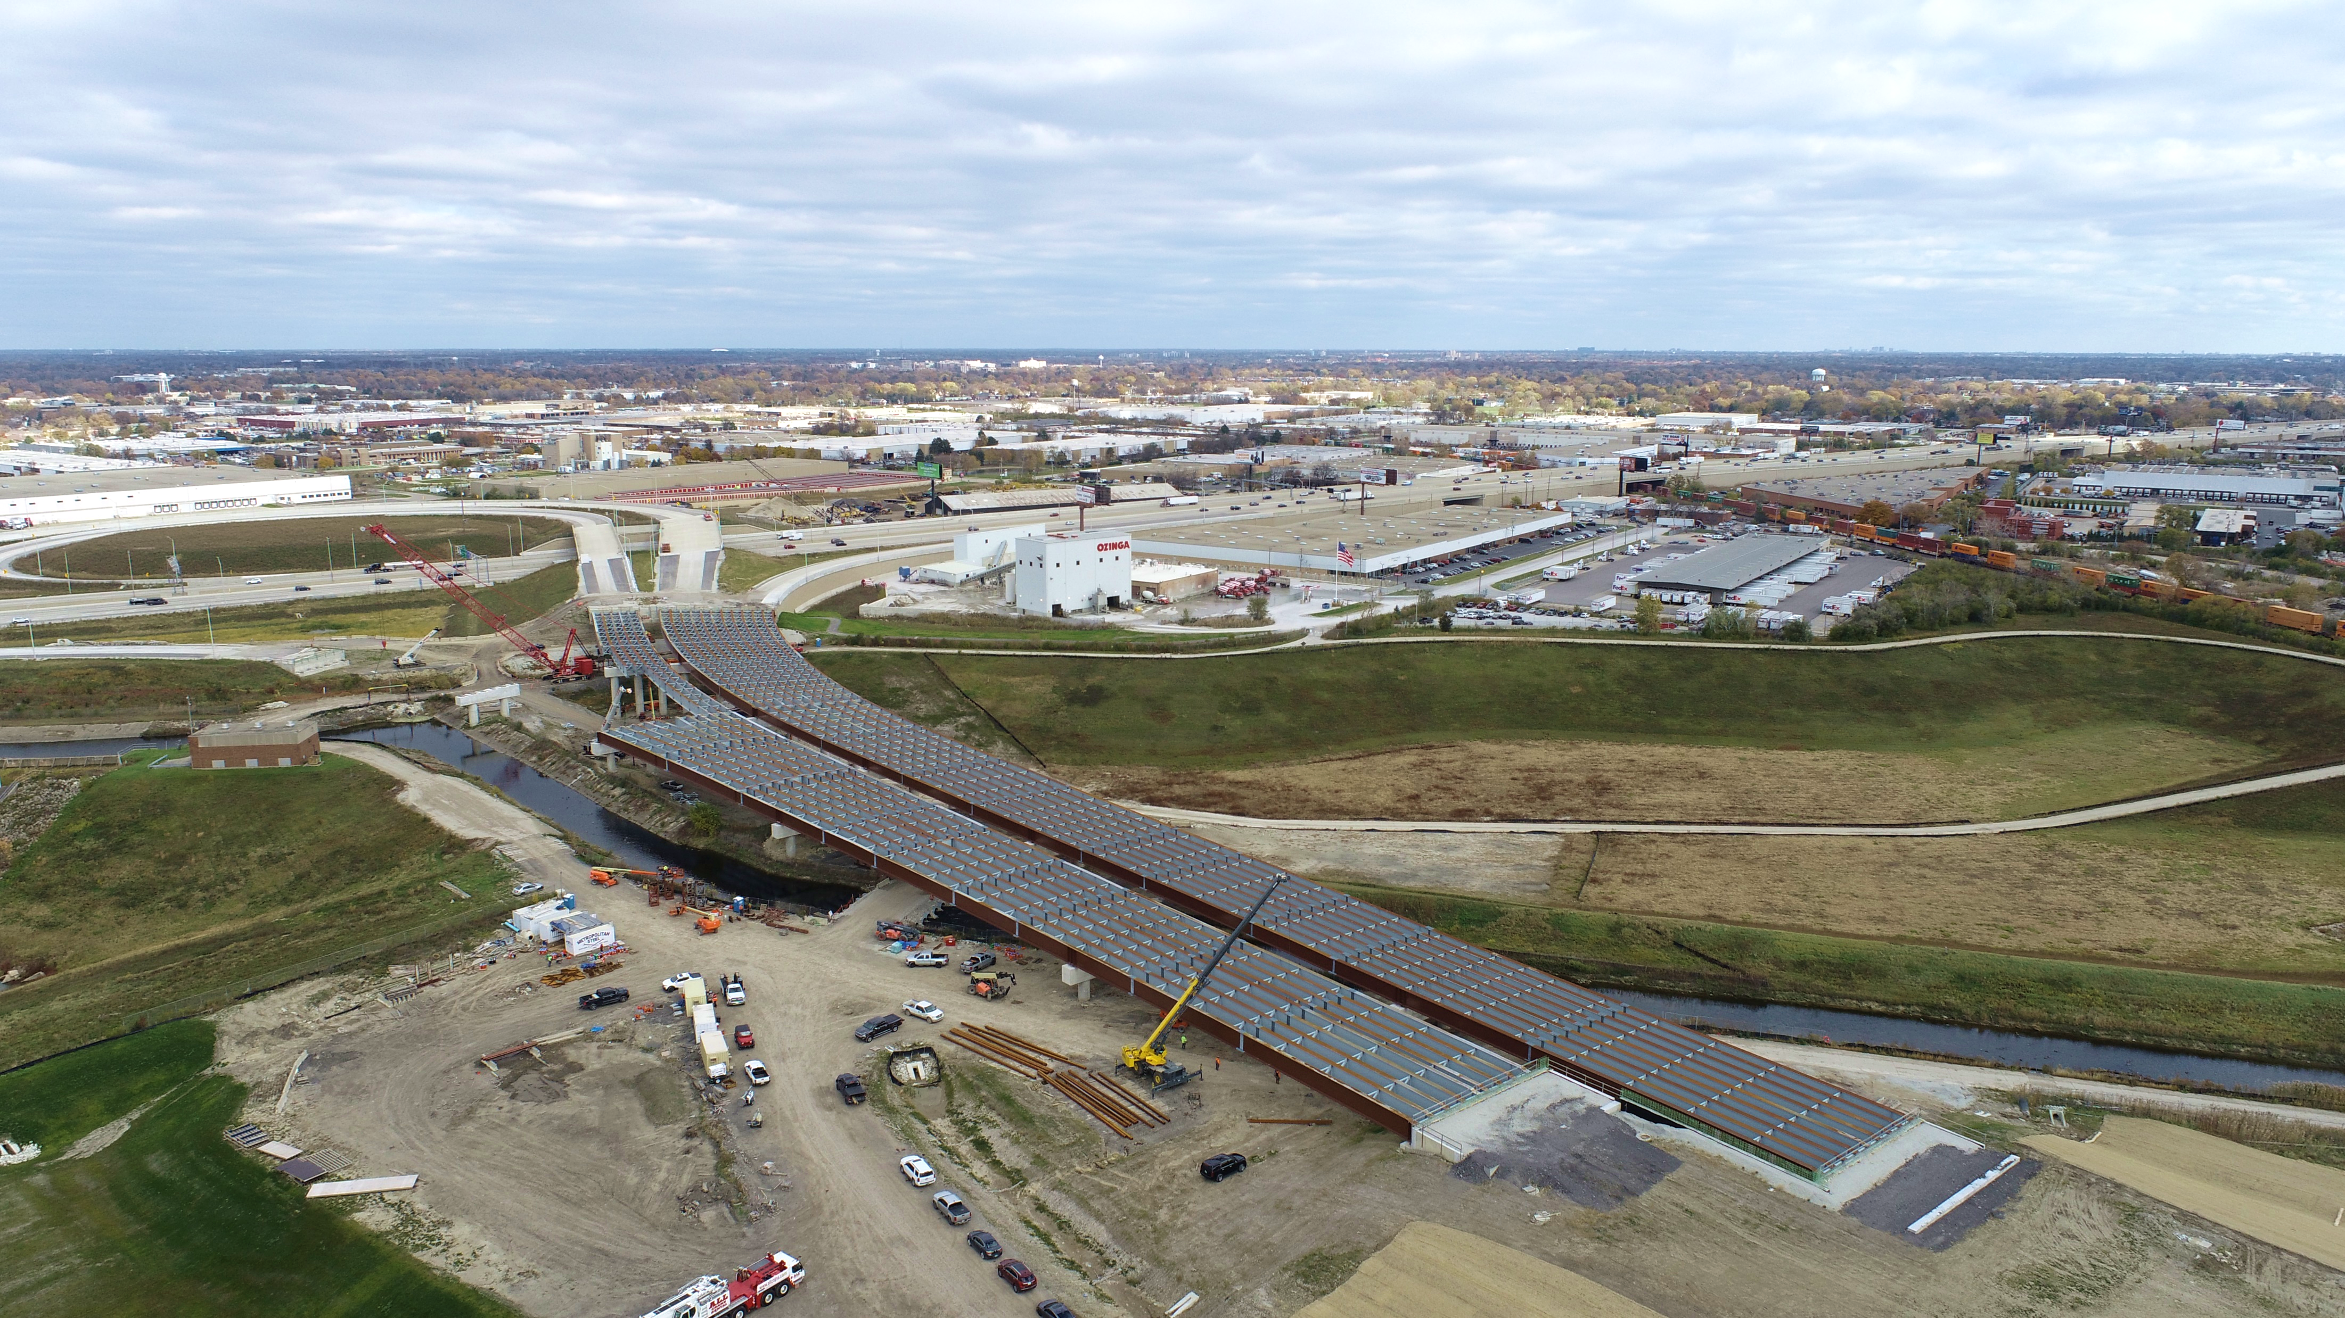
MOVE ILLINOIS STATUS | 2012 - SEPTEMBER 2023 (Q3) 12th year of 15-year, $14 billion capital program
76% COMPLETE
$12.2 BILLION COMMITTED
125,380 JOBS
825 CONTRACTS AWARDED
585 CONTRACTS CLOSED OUT

Slide 3
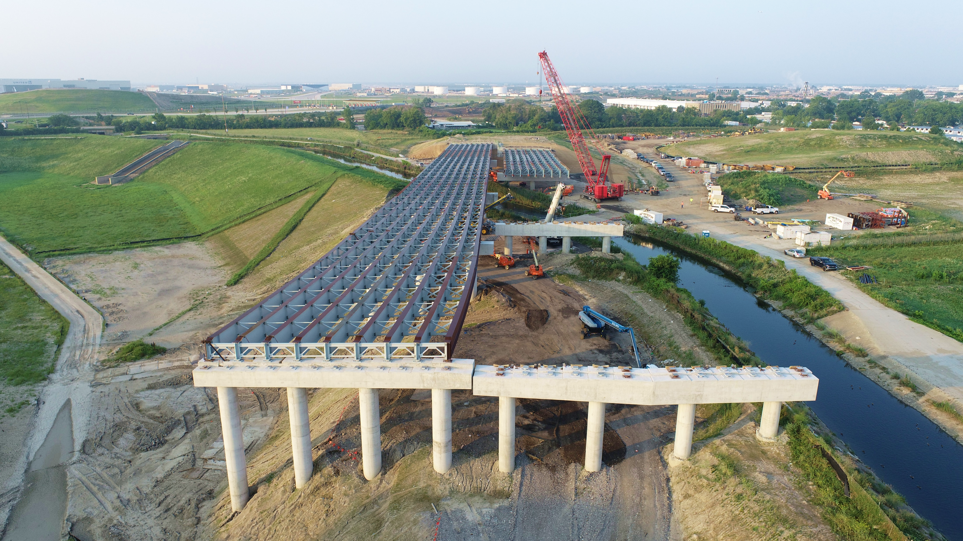
I-490 TOLLWAY CONSTRUCTION PROGRESS
3

Slide 4
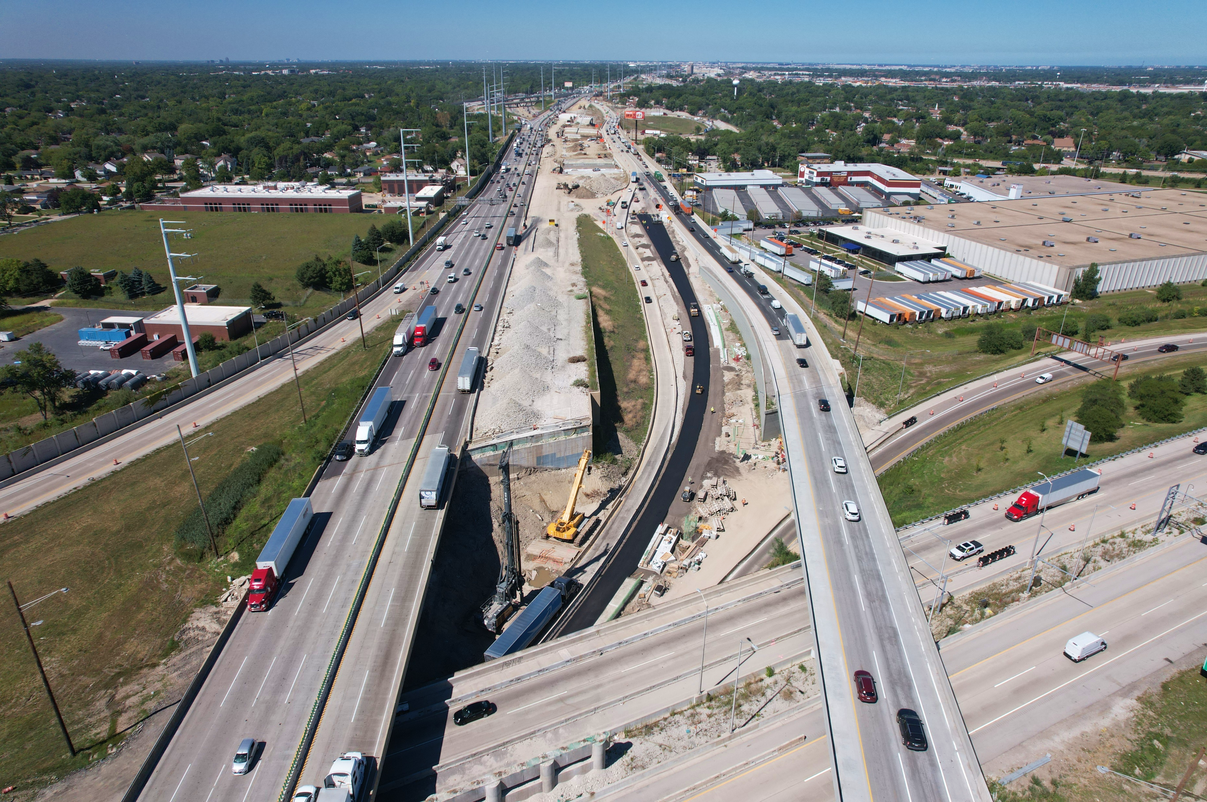
CENTRAL TRI-STATE TOLLWAY (I-294) CONSTRUCTION PROGRESS
CENTRAL TRI-STATE TOLLWAY (I-294) CONSTRUCTION PROGRESS
4

Slide 5
2024 ANTICIPATED QUANTITIES
271,000 cubic yards of unbound aggregate for all projects
Subgrade aggregate
Aggregate base course
Granular subgrade
Porous granular fill
Aggregate shoulder
150,000 square feet of mechanically stabilized earth retaining walls
226,000 cubic yards of concrete
155,000 tons of warm-mix asphalt

Slide 6
CTS CONTRACTOR QUANTITY REPORT
https://www.illinoistollway.com/doing-business/construction-engineering/cts-contractor-quantity-report

Slide 7
WEBSITE NAVIGATION
https://www.illinoistollway.com/doing-business/construction-engineering

Slide 8
PRODUCTS, SPECIFICATIONS
Porous granular embankment (PGE)
9 inches PGE will be used on the Central Tri-State Tollway(I-294) Project
Capping aggregate
3 inches over PGE will be used on I-294 Project
Porous granular subbase (PGS)
6 inches PGS will be used on I-490 Tollway Project
This is usually a washed CA-6
Porous granular backfill (PGB)
Mechanically stabilized earth (MSE) select fill
Material placed behind the MSE wall
TOLLWAY SPECIFICATIONS
Mechanically Stabilized Earth (MSE) Retaining Wall GBSP
Porous Granular Subbase (PGS) SP
Porous Granular Backfill (PGB) SP
Subgrade Aggregate SP – PGE and Capping Aggregate requirements
Production of Recycled Aggregate (PRA) SP – Requirements for materials processed on-site
Tollway Construction Memorandum 15-02

Slide 9
E-TICKETING IMPLEMENTATION OVERVIEW
Successful implementation began in 2022
Secure “agency portal" from HaulHub –DOTSlip
Integrates real-time ticketing data from any aggregate, asphalt, or concrete producer
Connects with any producer’s e-Ticketing vendor
Computer and mobile app access

Slide 10
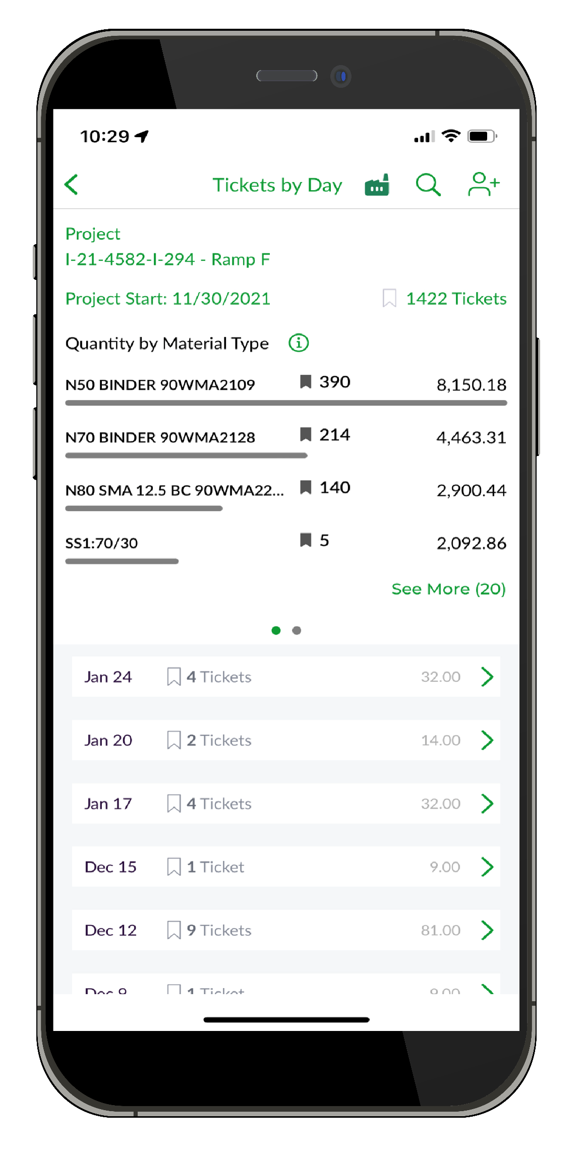
E-TICKETING IMPLEMENTATION OVERVIEW
Payment reconciliation
Tickets and quantities linked to pay items
Delivery report
Replaces printed tickets and adding machine tape
Summarizes placements
Stored electronically in e-Builder
Presented by Cindy Williams on December 5, 2022

Slide 11
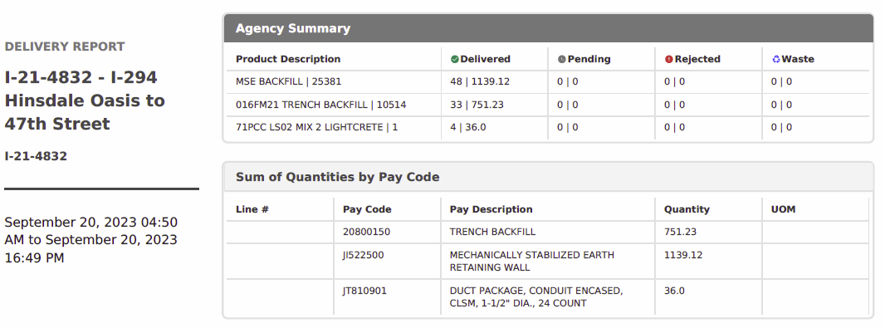
E-TICKETING SYSTEM Delivery Report

Slide 12
E-TICKETING SYSTEM Delivery Report

Slide 13
E-TICKETING SYSTEM Statistics
Currently
45 contracts – active and completed
53 producers/plants connected
230 users
44,282 tickets submitted to date in 2023

Slide 14
FOAMED GLASS LIGHTWEIGHT AGGREGATE
Sustainable
Recycled glass, processed, foamed and broken to aggregate size
Lightweight
Over underlying utilities or weak soil condition, in MSE wall, in lieu of lightweight concrete cellular fill
Research
Tollway research into application in local climate, testing, specification, environmental and economic impact
AeroAggregates

Slide 15
THANK YOU

Slide 16
QUESTIONS?
Cindy Williams
cmwilliams@getipass.com

