Slide 1
Work Related Silent Killers
MSHA TRAM CONFERENCE
2023

Slide 2
Question
How many in this room know of someone who died by suicide…family, friend, co-worker, or……?
I would like to begin by telling you a story about a man from Florida.

Slide 3
Falling, struck-by or crushed by equipment, electrocutions, powered haulage and more are what we typically think about as the causes of incidents, accidents and deaths in the construction industries.
A recent study found that another cause of death in the construction industries is people taking their own lives at an alarming rate.
In 2020, the CDC found that men working in construction have one of the highest suicide rates as compared to other industries. Their suicide rate is about four times higher than the general population” (Hashem: 2021).

Slide 4
The Center for Disease Control (CDC) indicates:
Suicide has become the 10th leading cause of death since 2008.
40% of U.S. adults reported struggling with mental health or substance abuse and 11% of U.S. adults seriously considered suicide (2020).
A 2020 study found that 83% of construction workers have experienced mental health issues (Sarah Lorek). She believes:
One of the biggest factors is that ”89% of construction workers are men”.
“Men underreport mental health issues and are less likely to receive appropriate treatment”.
“It is not a coincidence that men are also more likely to abuse drugs and alcohol and commit suicide…both are extreme forms of self-treatment for chronic mental health problems”.

Slide 5
Some Causes of Death by Suicide
COVID -19 | Unemployment | Job Dissatisfaction
Housing | Co-Worker Threats | Personal Relationships
Mental Health Issues | Substance Abuse | Death of a Family Member
Depression | Stress | Long Hours

Slide 6
Work-related stress can have severe impacts on mental health and, without proper support, may lead to substance abuse and even suicide.
“Workers in construction face many work-related stressors that may increase their risk factors for suicide, such as the uncertainty of seasonal work, demanding schedules and workplace injuries that are sometimes treated with opioids” (Jim Fredrick, Acting Assistant Secretary of Labor).

Slide 7
According to the CDC, the construction industry, when compared to other industries, has one of the highest suicide rates.
In 2016, the suicide rate for men in construction and extraction industries was:
53.2/100,000 workers
Almost twice the rate of other occupations—27.4/100,000.
In 2018, the suicide rate for workers in the construction industries was:
5 times more than that of all work-related fatalities (9.5/100,000).

Slide 8
Safety education and best practices have increased substantially over the past 25 years.
But mental health education, as it relates to worker safety, is rarely discussed, if ever.
Is not a workers’ mental health just as vital and should be emphasized as much as wearing PPE, fall protection and seat belts?

Slide 9
The Construction Industry Alliance for Suicide Prevention reports:
“many workers within the industry suffer in silence due to cultural expectations where a culture suggests being “macho” is considered the norm.
Despite advancements in education and awareness, mental health issues remain stigmatized in some circles, and suicide is a taboo topic on the jobsite.
As such, many workers feel forced to “deal with it,” and not seek the help they need, allowing their symptoms get worse.

Slide 10
Signs of Potential Mental Health Issues Which Could Lead To Suicide
Decreased Productivity | Increased Conflicts with Co-Workers
Near Hits, Incidents and Injuries | Decreased Problem-Solving Ability
Increased Tardiness or Absenteeism | Mental Disorders
Extreme Mood Swings | Alcohol or Substance Abuse
Impulsive or Aggressive Tendencies | Expressing Feelings of Hopelessness
Major Physical Health Issue | Family History
Deterioration in Personal Hygiene | Sense of Isolation
Discrimination in Workplace or Off-Work | Being Harassed or Bullied at Work
Loss of Job or Finances | Getting Divorced

Slide 11
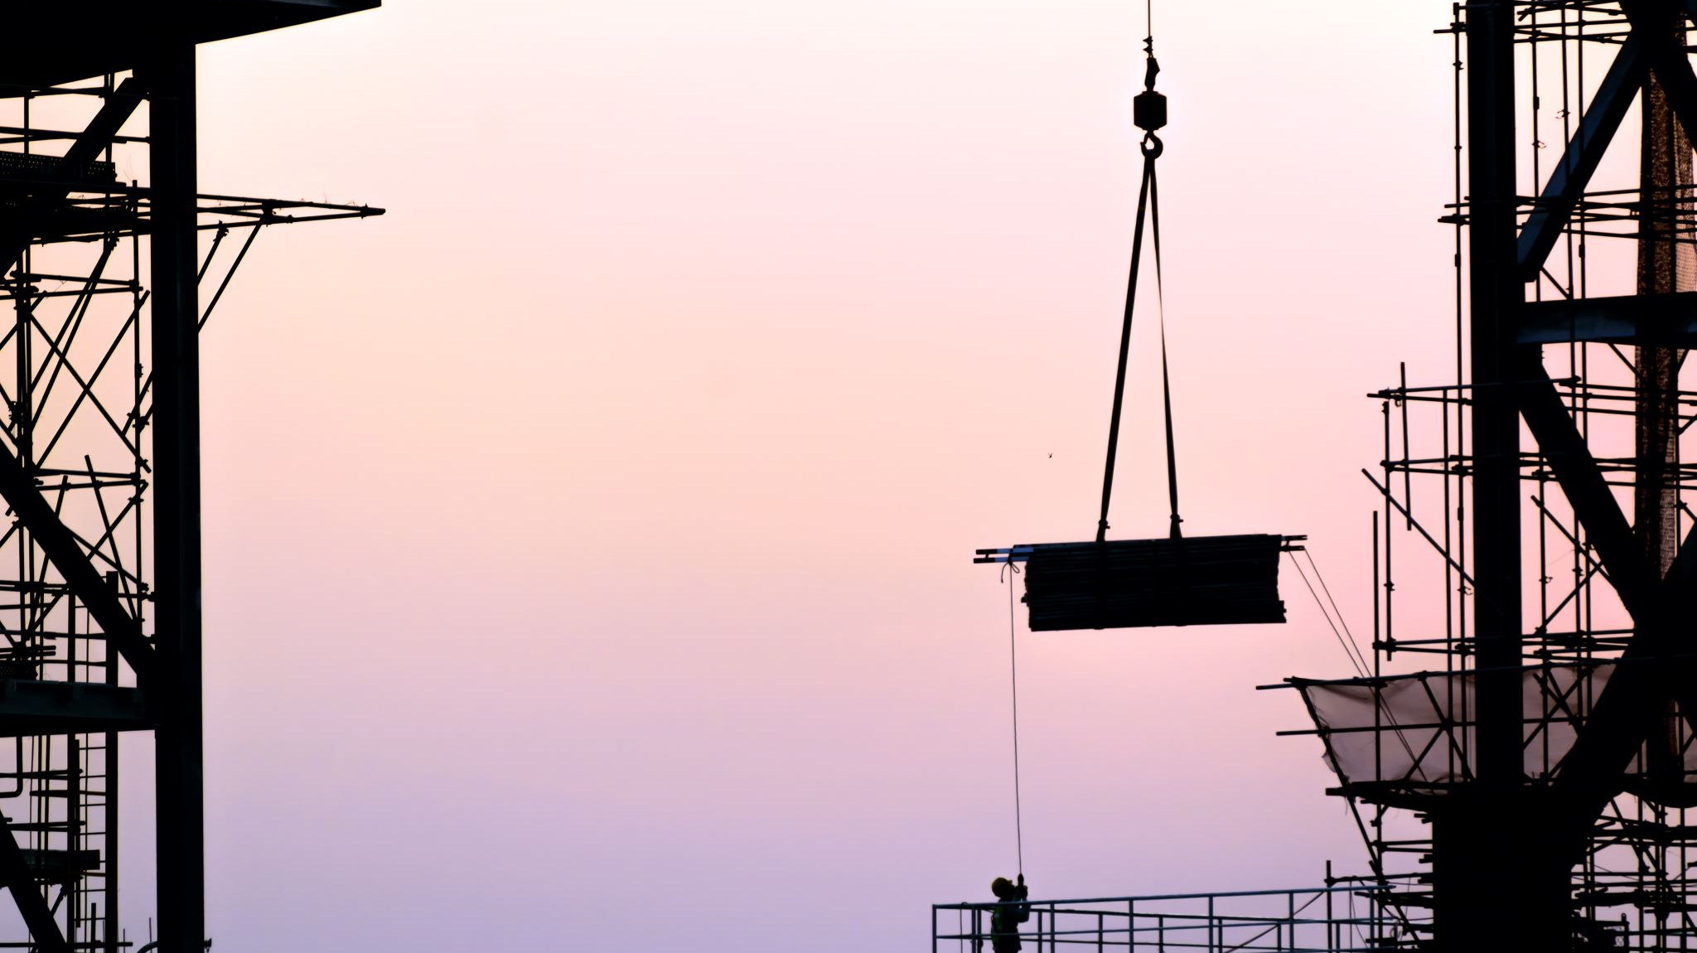
America Needs a Life-line
Every year in the U.S., more people die by suicide than are killed in car accidents and more suicide deaths occur than homicide and AID’s deaths combined.
For every person who dies by suicide annually, 316 people seriously consider it, but do not kill themselves.
The 988 SUICIDE & CRISIS LIFE-LINE:
This National Call Center, from 2005 to 2021, received 23,044,100 Calls to 988

Slide 12
Whether one is the company owner, president, a front-line or middle manager, safety director or a front-line worker, it is everyone’s responsibility to keep co-workers safe.
It is up to company management to promote and develop a culture which provides a safe place for workers to come forward when they experience mental health issues.
Ignoring or treating this topic as taboo will only continue the trend of rising suicides in the construction industries.

Slide 13
Fentanyl Use and Abuse
Based on mortality data from the National Occupational Mortality Surveillance System, workers in the extraction industries:
Have the highest mortality rates from natural and semisynthetic opioid–related overdose deaths, and
The second highest mortality rates from synthetic opioid-related overdose deaths, according to a study of occupations associated with drug overdose deaths.
There are currently 267,000 workers in the extraction industry; of these 46,725 (17.5% ) have an alcohol abuse problem; 13,350 (0.05%) used illegal drugs and 30,705 suffered from substance abuse addiction.

Slide 14
What Does Fentanyl Do and How Is It Misused?***
Fentanyl is a powerful painkiller
The Centers for Disease Control, indicates it is up to 100 times more potent than morphine.
Because of its strong potency, it is used in operating rooms, to control pain after surgery and to alleviate pain for people with advanced cancer.
Its effectiveness at relieving pain and increasing pleasure also have made it a popular street drug with the risks of addiction, overdose and death.

Slide 15
Fentanyl Is Available In A Variety Of Forms:
Pharmaceutical fentanyl is a synthetic opioid, a lab-created compound, used under medical supervision. It can come in a variety of formats including:
Nasal spray: to treat cancer pain. | Patch for the skin: to for pain after surgery.
Injection: for pain during/ or after surgery. | Oral spray, tablet or lozenge: for cancer pain
There are more than 30 non-pharmaceutical types of fentanyl on the illicit drug market, many of which cannot be detected by standard urine drug screens.

Slide 16
What Fentanyl Does To Your Body:
As an opioid, fentanyl attacks to opioid receptors in brain cells and helps decrease feelings of pain. It can increase feelings of pleasure, often referred to as euphoria. Other effects can include drowsiness, nausea, confusion, constipation and addiction.
In addition to the euphoric feeling fentanyl can produce, those who are addicted to fentanyl can experience unpleasant withdrawal symptoms such as muscle pain, bone pain, diarrhea, vomiting, cold flashes and uncontrollable leg movements.
Whether prescribed or obtained illegally, there are serious risks to using fentanyl when it is not used correctly, especially if you take too much or combine it with certain other medicines or alcohol.

Slide 17
How Fentanyl Can Be Misused:
While fentanyl is legally manufactured and distributed in the U.S., it can be stolen, obtained with fraudulent prescriptions or made in illegal labs.
Illicitly manufactured fentanyl can be sold as powder, nasal spray or pills that look like other prescription opioids.
Fentanyl is known by street names such as Apache, China Girl, Dance Fever or Goodfellas.

Slide 18
The Drug Enforcement Administration (DEA) says a very small dose, just two milligrams, can be lethal.
Illegal fentanyl can be used in the same ways as prescribed fentanyl,
It can be misused by snorting or smoking it.
Some remove the gel contents of a fentanyl patch and then inject or ingest the contents.
Others freeze patches and then place frozen pieces under the tongue.
Additionally, some people use the ultrapotent fentanyl analog carfentanil, which is legally used to sedate large animals.
Fentanyl misused in this manner is not only dangerous, but deadly.

Slide 19
Synthetic opioids like fentanyl are the most common drugs involved in overdose deaths.
Between 2020 to 2021, 80,000 Americans died of problems related to synthetic opioids and unfortunately, the death toll continues to rise dramatically.
The number of synthetic opioid overdoses increased 97-fold from 1999-2021.
Overdose deaths involving synthetic opioids in 2020 were 18 times the number in 2013.
During 2022, 110,000 people in the U.S. died from drug overdose; 68% involved the use fentanyl or fentanyl-laced drugs

Slide 20
In 2022, the DEA seized more than 50 million street pills laced with fentanyl, more than twice as many as in 2021.
Of the fentanyl-laced street pills analyzed by the DEA in 2022, 60% contained a potentially lethal dose of fentanyl.
Fentanyl is increasingly found in street drugs that have been stamped with illegally purchased pill presses to look like other common pharmaceutical-grade drugs, such as oxycodone

Slide 21
The internet has made buying almost anything online an option.
It is crucial to use extreme caution when getting medication or products marketed as “natural alternatives” from someone other than your health care provider.
There have been situations where people thought they were buying natural products, including weight-loss supplements, cannabis and anti-anxiety medications, and instead got fentanyl-laced drugs.

Slide 22
The U.S. Drug Enforcement Administration (DEA) says there has been “sharp increase in the trafficking of fentanyl mixed with Xylazine,” an animal tranquilizer referred to on the streets as “Trang.”
DEA Administrator Anne Milgram said “DEA has seized Xylazine and fentanyl mixtures in 48 of 50 states. The DEA Laboratory System reported in 2022 approximately 23% of fentanyl powder and 7% of fentanyl pills seized by the DEA contained Xylazine.”
Federal and state agencies also warn that those who inject drug mixtures containing Xylazine, or are exposed to it, can cause severe, necrotic skin ulcerations, described as “skin rot,” which may lead to amputation.
Xylazine is not an opioid, Narcan does not reverse opioid overdose effects

Slide 23
https://www.newsweek.com/dea-issues-dire-warning-fentanyl-mixed-flesh-eating-tranquilizer-1789085 Fentanyl Abuse (1.25 Minutes)
https://youtu.be/AvTcg1X_faE?si=kZklwf-vIBVx9aAS Mental Health (10 Minutes)

